Slide 1
Chapter 10.1
Early Civilizations in Africa

Slide 2
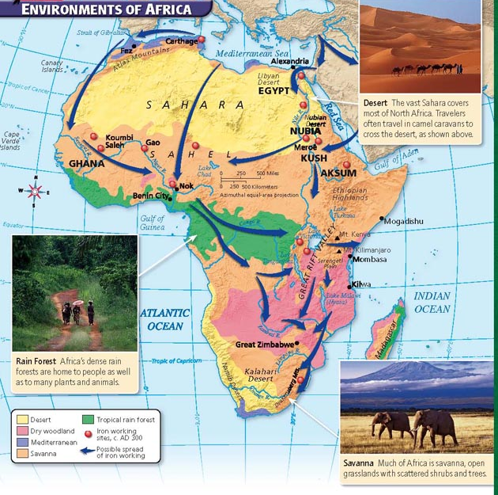

Slide 3
Geography of Africa
Landforms
Low wide plains run across the northern and western interior
Vast plateaus, or high plains, cover much of Africa’s central and southern interior
Valleys, lakes, mountain ranges, deserts, swamps, and sandy beaches

Slide 4
More than 3 times the size of America
Wide variety of climates and vegetation
Three vegetation regions found in Africa
Sahel
Savanna
Tropical rain forest
Three additional environmental regions include
Mediterranean
Dry woodland
Desert

Slide 5
Also, the coastal regions…

Slide 6
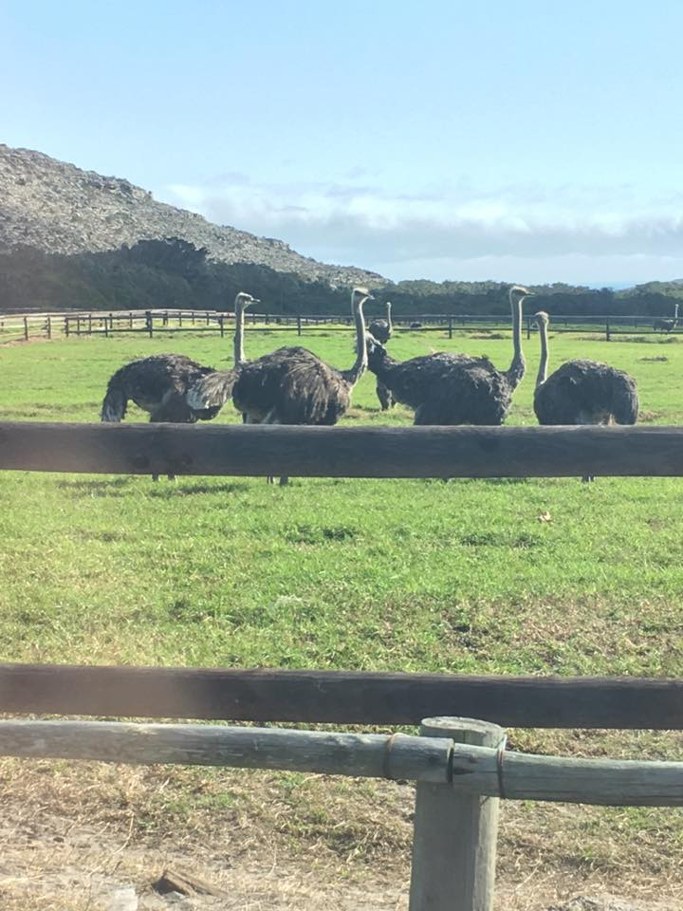

Slide 7
The Sahel
South of Sahara, mighty rivers flow across plains, including Congo, Zambezi, Niger
Region called the Sahel, strip of land dividing desert and wetter areas
Sahel fairly dry, but has vegetation to support hardy grazing animals

Slide 9
The Savanna
Farther south, band of tropical savanna, open grassland
Extends east from Central Africa, wraps back toward south
Tall grasses, shrubs, trees grow there; variety of herd animals
The majority of Africans live there

Slide 13
Tropical Rain Forests
Tropical rain forests found near equator and on Madagascar, an island off southeast coast
Hot, humid climate and year-round rainfall of rain forest supports broad range of plant and animal life

Slide 14
Adapting to Africa’s Environment
Varied Climates
First people to live in Africa had to adapt to varied climates and features
Insufficient water supplies and poor soil in some places made farming difficult
Rains
Rainfall—too much, too little—presented problems that continue today
Heavy rains erode soil and wash away nutrients important for growing crops
Insufficient rainfall leads to drought and poor grazing land
Farmers must decide which crops to grow based on expected rainfall

Slide 15
Insects and Parasites
Parasites thrive in tropical areas; transmitted by mosquitoes to humans, animals; can lead to deadly diseases like malaria
The tsetse fly, sub-Saharan Africa, carries parasite that can kill livestock and infect humans with sleeping sickness, a potentially fatal illness

Slide 16
Early Farming Societies
9,000 years ago
Africans began to farm and leave behind lives as hunter-gatherers
There is some archeological evidence that the first farms were in the Sahara nearly 8,000 years ago
It was much wetter than it is now.
5,000 years ago
The climate changed and the Sahara became drier.
Pastoralists (those who practiced raising herd animals) migrated to the Mediterranean coast, the Nile Valley, and parts of West Africa.

Slide 17
Religion and Culture
Many early Africans shared similar religious beliefs and shared common features in the arts as well.
Examples of Beliefs
Many believed that unseen spirits of ancestors stayed near
To honor spirits, families marked certain places as sacred places, put specially carved statues there
Families gathered to share news, food with ancestors, hoping spirits would protect them
Animism
Many Africans also practiced form of religion called animism—belief that bodies of water, animals, trees, other natural objects have spirits
Animism reflected Africans’ close ties to natural world

Slide 18
Griots
Many early societies did not develop systems of writing
They maintained sense of identity, continuity through oral traditions
Included stories, songs, poems, proverbs
The task of remembering was entrusted to storytellers called griots

Slide 19
Music and Dance
In many societies, music and dance were central to many celebrations and rituals
Carving and wearing of elaborate masks part of these rituals as well
Early Africans excelled in sculpture: bronze as well as terra cotta
Traditional music performed with variety of wind, stringed instruments

Slide 20
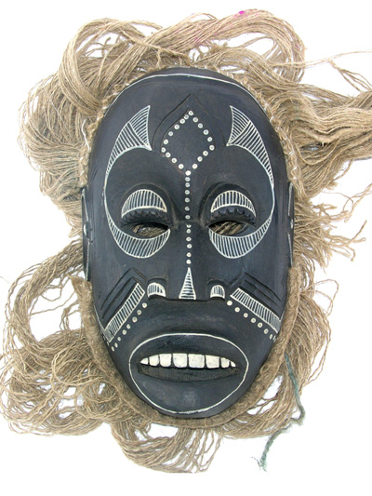

Slide 21
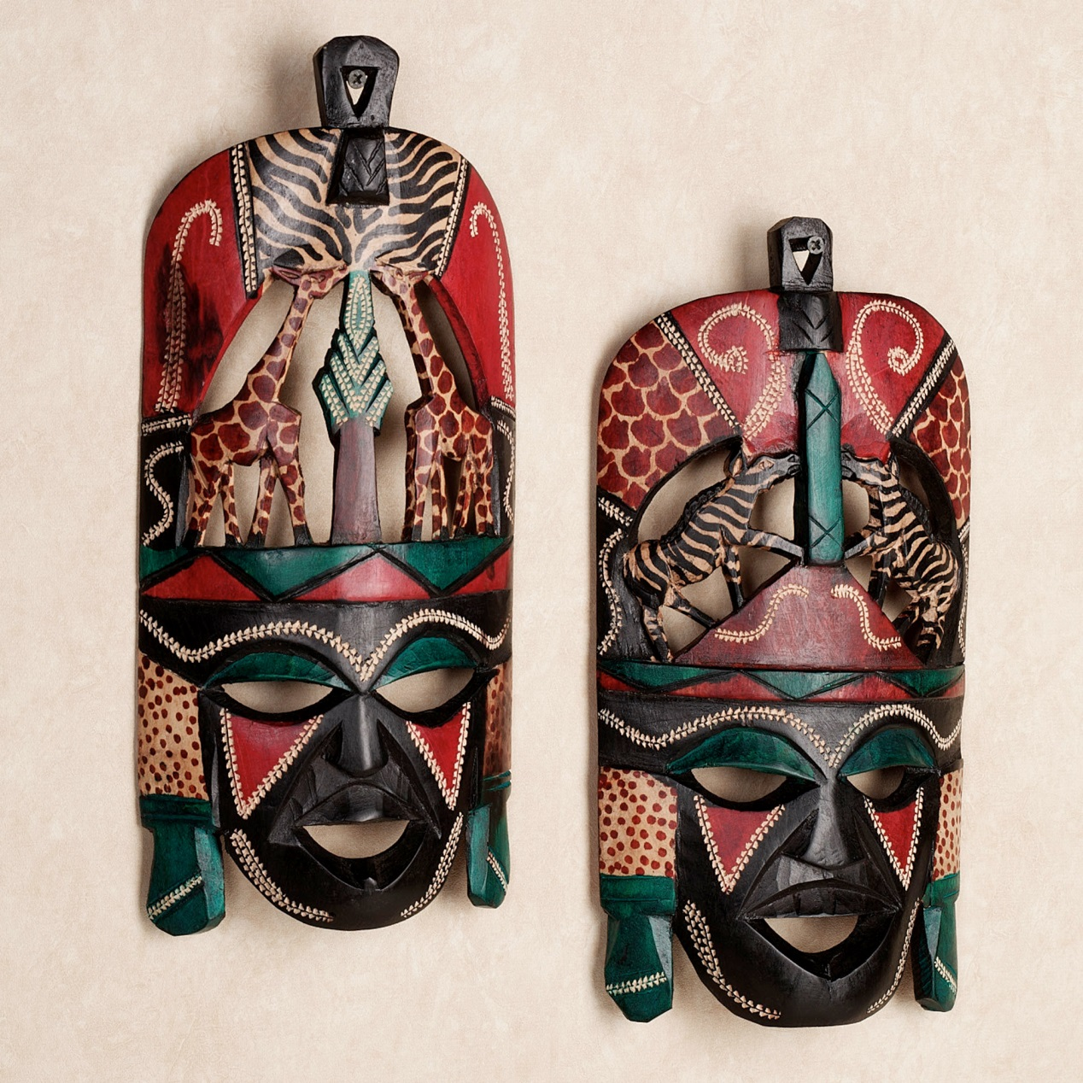

Slide 22
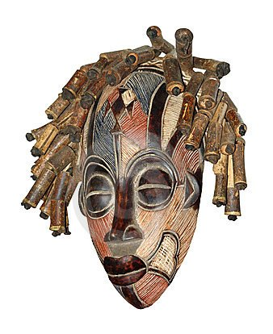

Slide 23
Africa’s Iron Age
The spread of iron technology after the 500s BC changed farming practices in sub-Saharan Africa. As a result, African society changed.
Nok were some of earliest known peoples to practice ironworking techniques for refining iron ore to iron
Now possible to produce tools and weapons superior to those they had made before.

Slide 24
Language
Bantu
A family of closely related African languages
This is also what any of the people who speak the language are called languages spoken in central and southern Africa, including Swahili, Xhosa, and Zulu.
EXAMPLE 1
EXAMPLE 2

Slide 25
END

