Slide 1
Chapter 10.3
Kingdoms of West Africa

Slide 2
Main Idea The expansion of trade across the Sahara led to the development of great empires and other states in West Africa.
Learning objective: Students will be able to analyze -
How did trade contribute to the rise of Ghana?
How did strong rulers build the empire of Mali?
What were the greatest achievements of the Songhai Empire?

Slide 3
Empire of Ghana

Slide 4
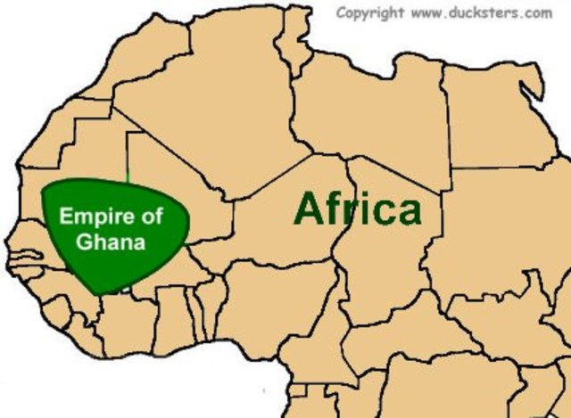
Empire of Ghana
West Africa produced valuable resources—notably gold—that brought high prices.
Trade was difficult because of the desert.
By the 800s, rulers of Ghana had used the wealth from these products to create a huge, powerful empire.

Slide 5
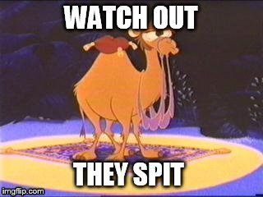
Rise of Ghana
Ghana had many resources, but location delayed development as trading empire
Had no easy access to sea
Sahara desert blocked overland trade routes
North African traders learned how to cross Sahara using
Large caravans
Camels
did not need much water
could survive trip across harsh desert

Slide 6
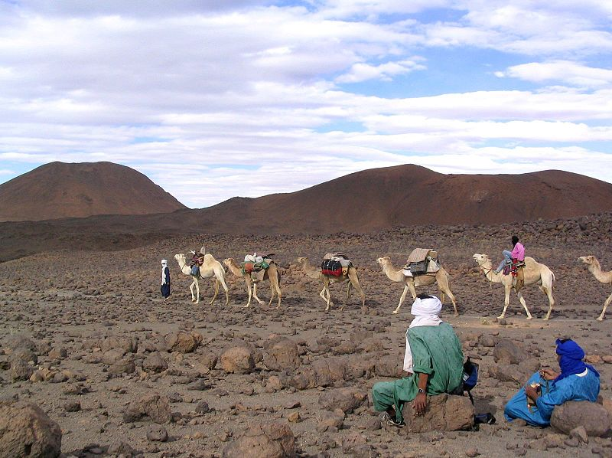

Slide 7
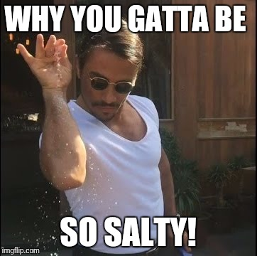
Ghana Gold
Ghana Salt
Gold Supply Scarce
Gold not taxed the same; taxes might discourage traders from buying gold
Only kings could own large gold nuggets
Others could only own gold dust; kept location of gold mines secret
This kept supply of gold scarce; kept market from being flooded
KEPT THE PRICE OF GOLD HIGH
Salt Taxes
Ghana’s kings built great wealth taxing goods brought to empire’s markets
Majority of taxes charged on salt: charged fee for each load of salt brought into Ghana from north, larger fee for each load exported to south

Slide 8
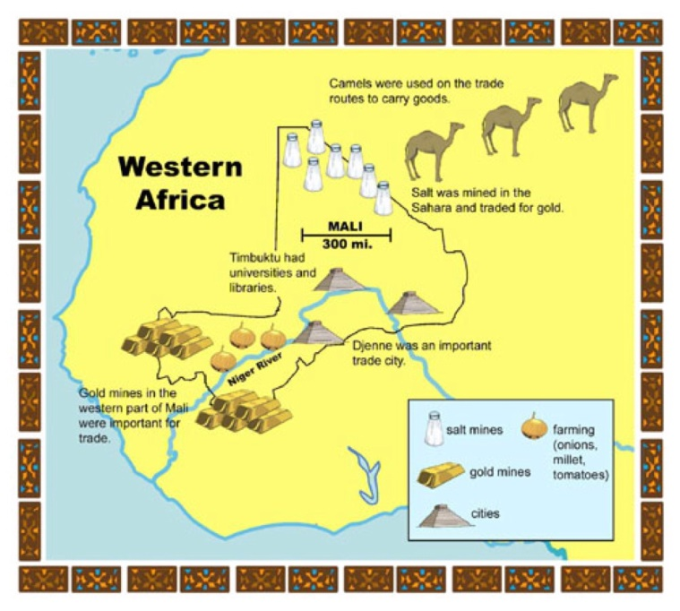
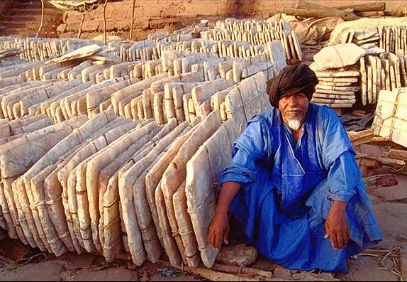
Salt Mines of Mali
The Impact of the Salt Trade
Notes:
VIDEO: Salt Mines of Mali https://www.youtube.com/watch?v=mZ1eQ99Triw
VIDEO: The Impact of the Salt Trade http://worldhistorytoday.weebly.com/african-civilizations.html

Slide 9
Empire of Mali

Slide 10
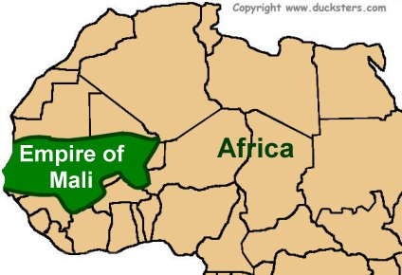
Mali
Ghana declined and no one kingdom controlled trans-Saharan trade.
In the 1230s, the empire of Mali rose to power on the same territory.
Mali expanded to the Atlantic Ocean and became a wealthy and sophisticated empire

Slide 11
Rise of Mali
Founders of Mali, Malinke had been active in Ghana’s gold trade
He grew frustrated with policies of neighboring peoples
rose up to conquer them
became leading power in West Africa

Slide 12
Mansa Musa
Mali reached its height in the 1300s under the reign of a mansa (king) named Musa
During Musa’s reign, Mali grew very wealthy thanks to taxation of gold-salt trade
Mali kept order along Saharan trade routes by using large army
Army also kept life in Mali relatively peaceful
Mansa Musa was a devout Muslim
In Mali, Islam became powerful influence, especially among ruling class
1324, Musa set out on hajj, pilgrimage to Mecca

Slide 13
Mansa Musa Pilgrimage
Good
Not so good?
On Musa’s trip to Mecca, he impressed people with lavish clothing & generous gifts
Upon returning home, Musa made Timbuktu a center of
Education
Religion
Culture
Musa’s hajj brought Mali to attention of Europe causing:
Mali began to appear on European maps for first time
Europeans to search West Africa for the source of Mali’s riches

Slide 14
Decline of Mail
Rulers following Musa were not as strong
Several peoples broke away and set up independent kingdoms
Mali also invaded from outside
Timbuktu was captured, a blow from which Mali never recovered

Slide 15
Empire of Songhai

Slide 16
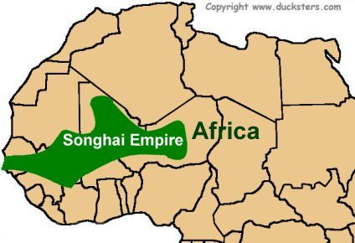
Empire of Songhai
Songhai existed as small kingdom for centuries,
Paid tribute to both Ghana and Mali
Grew wealthy trading goods along Niger River
In the 1460s, rulers became strong, rich enough to take control of former empire of Mali

Slide 17
Songhai’s leaders
Sunni Ali
Askia Muhammad
Songhai’s rise attributed to the military leader Sunni Ali
Ali’s first act as leader: take Timbuktu
He led a number of campaigns against neighboring peoples to build empire
He conquered new territories, replaced local leaders with Ali’s own followers
Songhai’s culture reached height under Askia Muhammad
Reign considered to be golden age
During 35 years he ruled, Askia Muhammad expanded Songhai and strengthened its government

Slide 18
Pilgrimage
Result of the Pilgrimage
Askia Muhammad was Songhai’s first Muslim ruler
He decided to make pilgrimage to Mecca
Traveled through Egypt & gained support of Muslim rulers
During pilgrimage, he made contact with traders from North Africa
Trans-Saharan trade resumed, making Songhai a very wealthy kingdom
Once again, Timbuktu became a center of culture

Slide 19
END

