Slide 1
Chapter 11
Cultures of East Asia

Slide 2
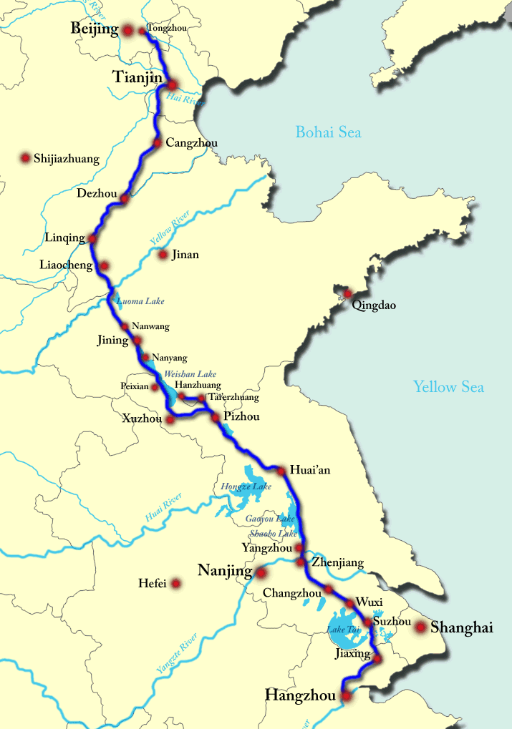
11.1 Chinese Empires
Chaos at the end of the Han Dynasty was known as the PERIOD OF DISUNION
The SUI (sway) Dynasty
Innovations: THE GRAND CANAL – 1,000 mile waterway connecting North and South China
Trade: internal changes b/c of the canal
Decline: 618 AD, Laborers died during the building project, causing rebellion. The ASSASSINATION OF THE EMPEROR ended it.

Slide 3
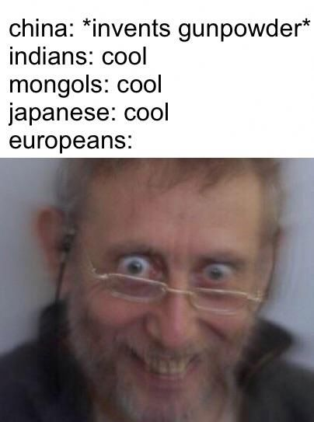
11.1 Chinese Empires
The TANG (tahng) Dynasty
Innovations: magnetic compass, woodblock printing, GUNPOWDER
Trade: foreign trade expansion due to improvements in shipbuilding
Decline: 750s, a rebellion weakened the dynasty. The ASSASSINATION OF THE EMPEROR ended it.
Notes:
VIDEO The deadly irony of gunpowder - Eric Rosado: https://www.youtube.com/watch?v=mqHVRgCkCDE

Slide 4
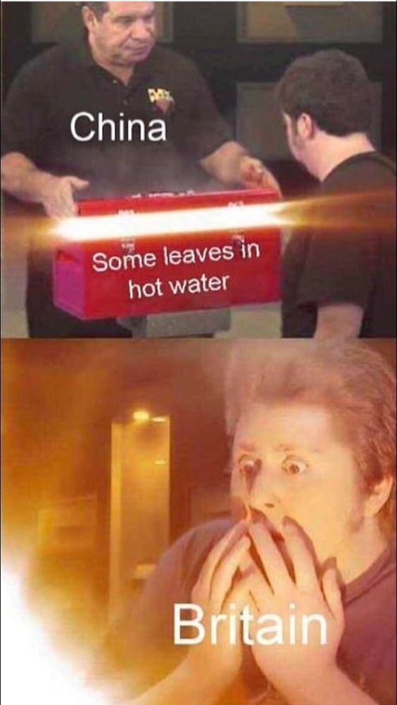
11.1 Chinese Empires
The SONG (song) Dynasty
Innovations: MOVABLE TYPE PRINTING
Trade: a strong, prosperous economy led to the development of a MONEY AND BANKING system
Decline: 1279 AD, Kublai Khan defeated the last Song ruler to take control of China
Notes:
VIDEO :

Slide 5
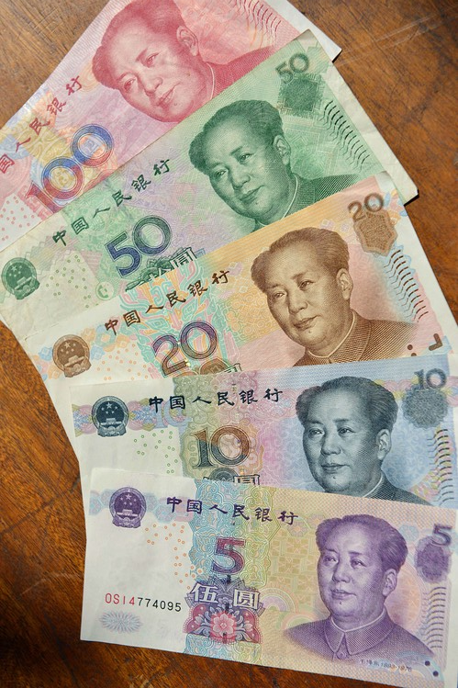
11.2 Mongol Empire
The YUAN (you-on) Dynasty
Innovations: expansion of the Grand Canal
Trade: Mongol policies opened trade in China to Europeans, leading the way for the spread of the BLACK DEATH
Decline: The death of Kublai Khan in 1294 AD and rebellion of Chinese factions caused the Mongols to flee to Manchuria.

Slide 6
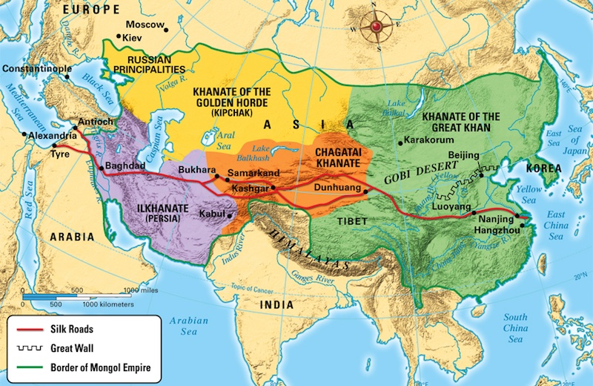
11.2 Mongol Empire

Slide 7
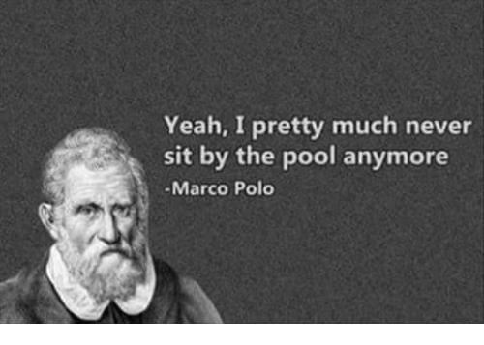
11.2 Mongol Empire
And then, this guy showed up…
Notes:
VIDEO (Who Was Marco Polo?): https://www.youtube.com/watch?v=sl8gQwX4Qlg

Slide 8
11.2 Mongol Empire
Marco Polo
Imprisoned upon his return home, Polo detailed his journeys.
Europeans were fascinated by the stories of the distant land.
What effect did this have?

Slide 9
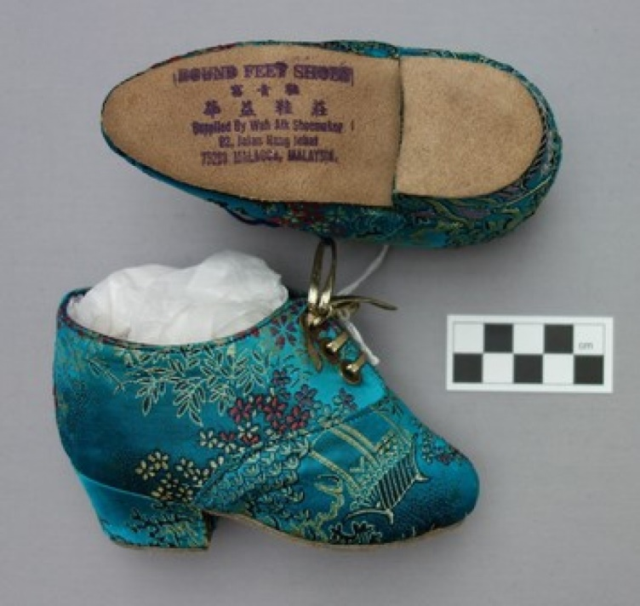
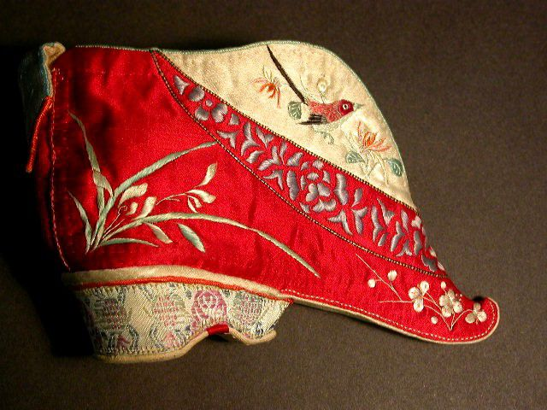
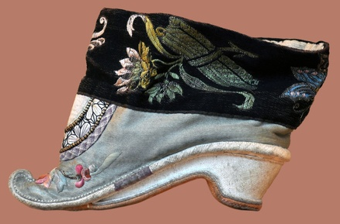
Foot binding: one of the reasons people suspect Marco Polo’s stories of not being firsthand accounts
Notes:
VIDEO (foot binding): https://www.youtube.com/watch?v=NuuIoJGPjBA

Slide 10
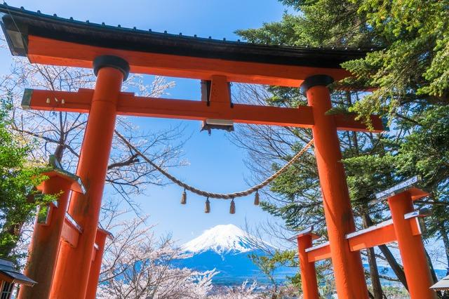
11.3 Japan and Korea
Early Japan
Shinto
Kami
Torii
Notes:
VIDEO (What Is The Ancient Japanese Religion Shinto?): https://www.youtube.com/watch?v=LoQqxdAbRS0

Slide 11
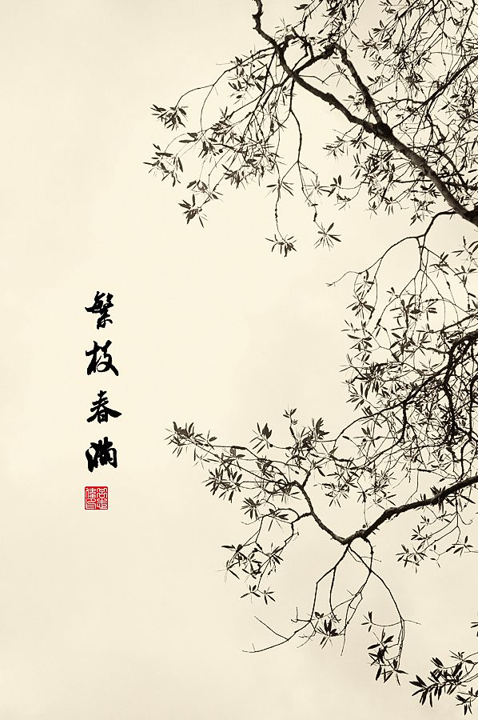
11.3 Japan and Korea
During the Chinese Tang Dynasty, Japan was greatly influenced by CHINA
Buddhism
Clothing
Art
Gardening
Dance
Confucianism
Roles of family

Slide 12
11.4 Civilizations of Southeast Asia
Both China and India had a huge influence on Southeast Asia
Trade led to the mass spread of BUDDHISM, HINDUISM, and eventually ISLAM
Map question 1
Map question 2

Slide 13
11.4 Civilizations of Southeast Asia

Slide 14
Homework
Write a lost journal entry from the POV of Marco Polo about your experience in a Chinese / Mongol trading center.
Be sure to use all FIVE senses to describe your experience (use the “History’s Voices except on p. 320 as reference).
Your goal is to increase interest for European travelers.

Slide 15
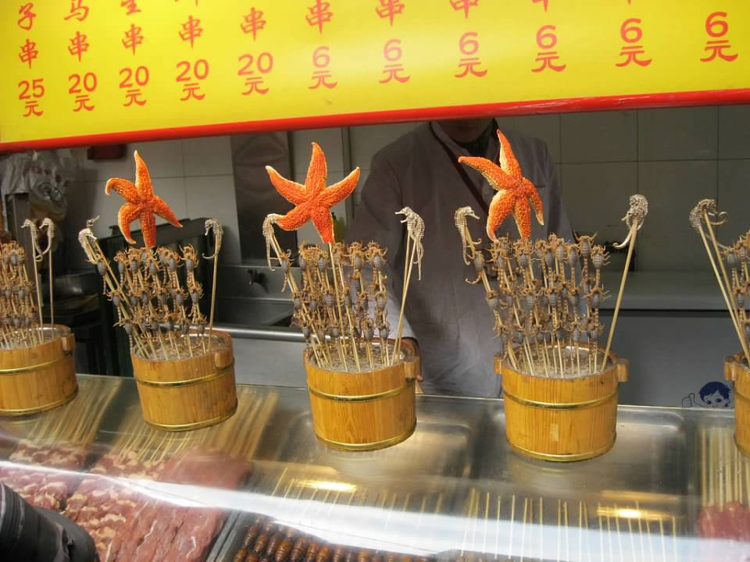
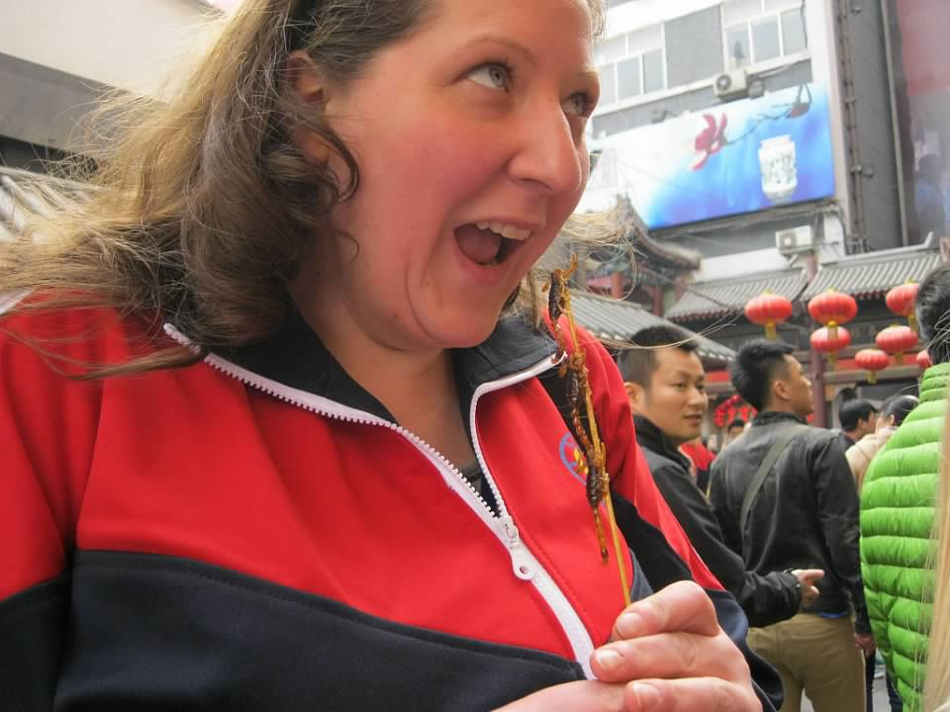
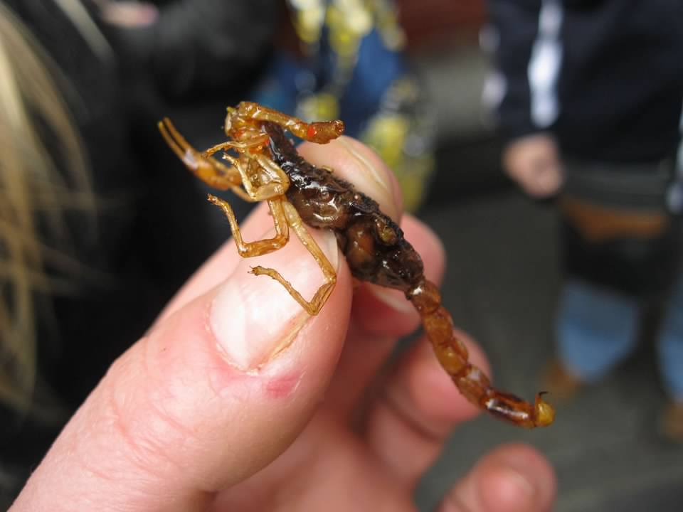

Slide 16
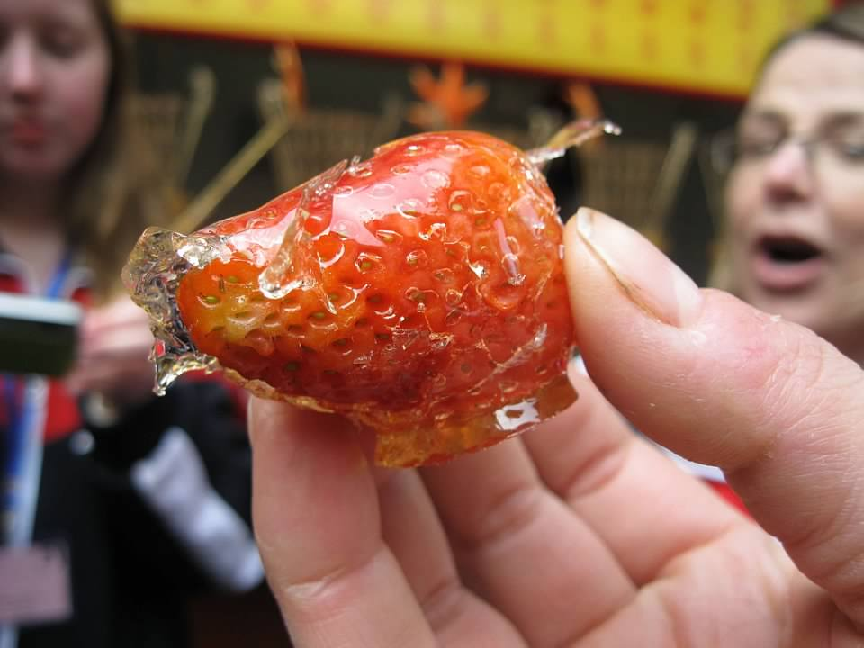
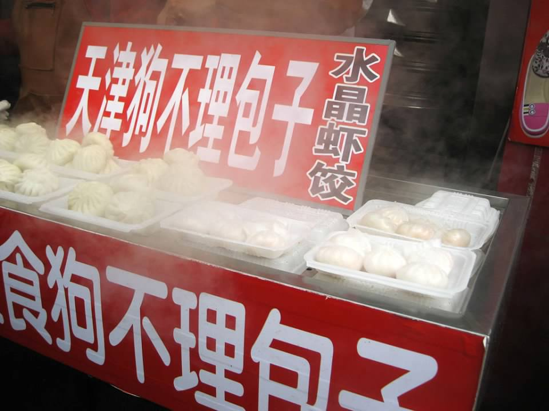
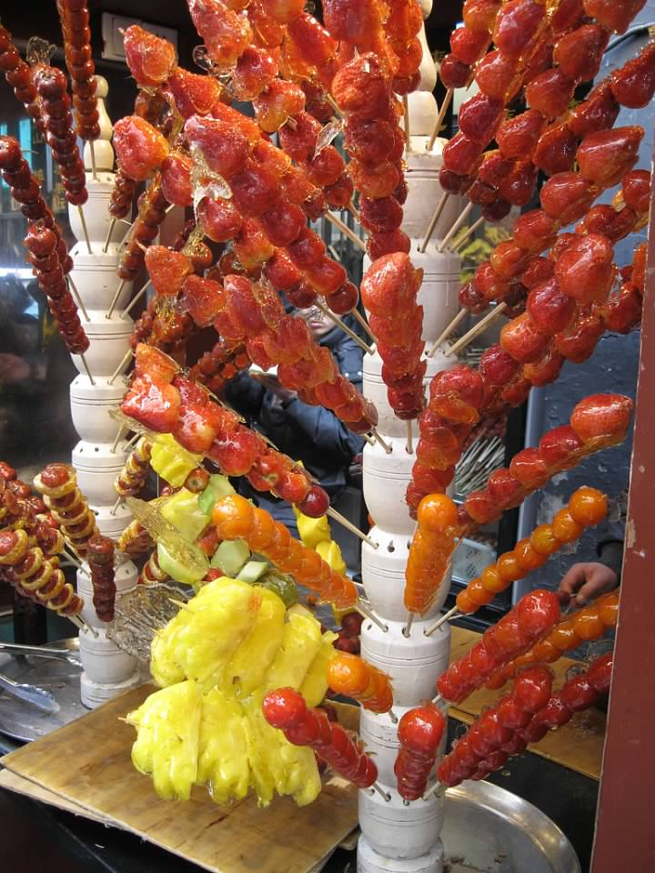
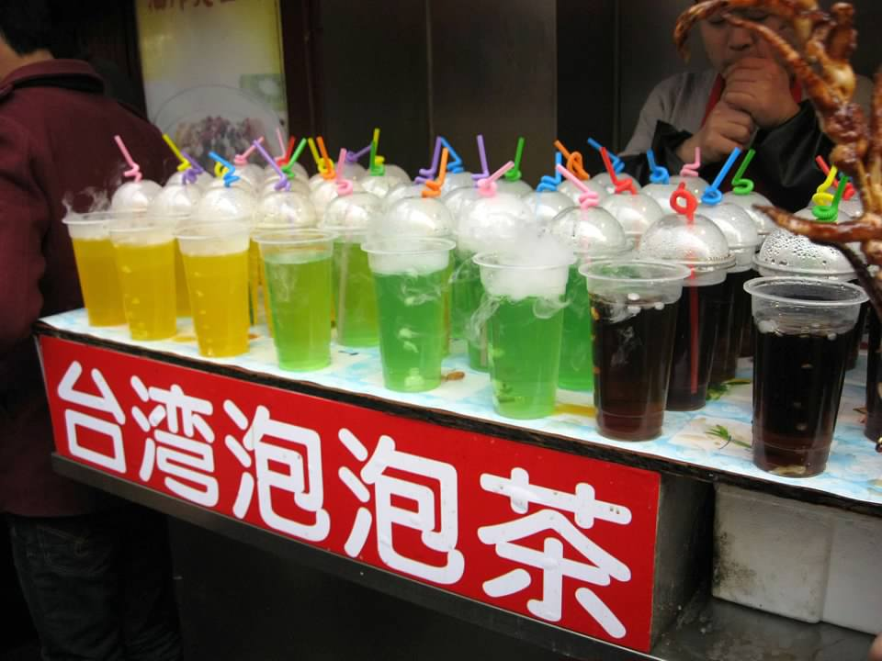

Slide 17
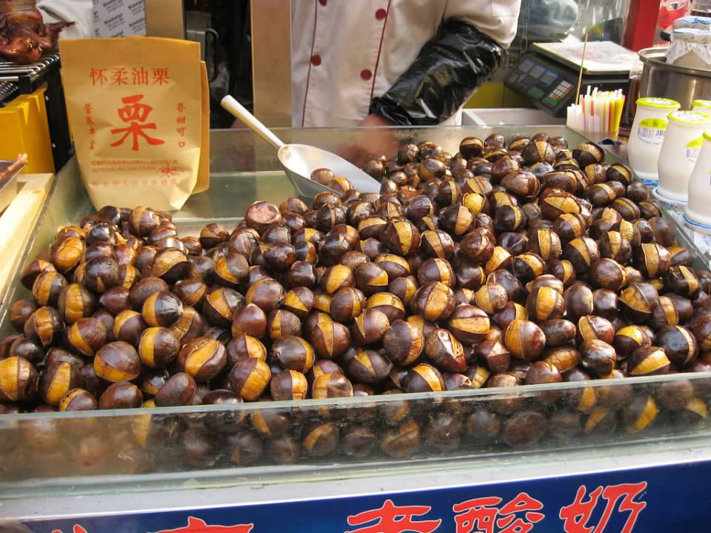
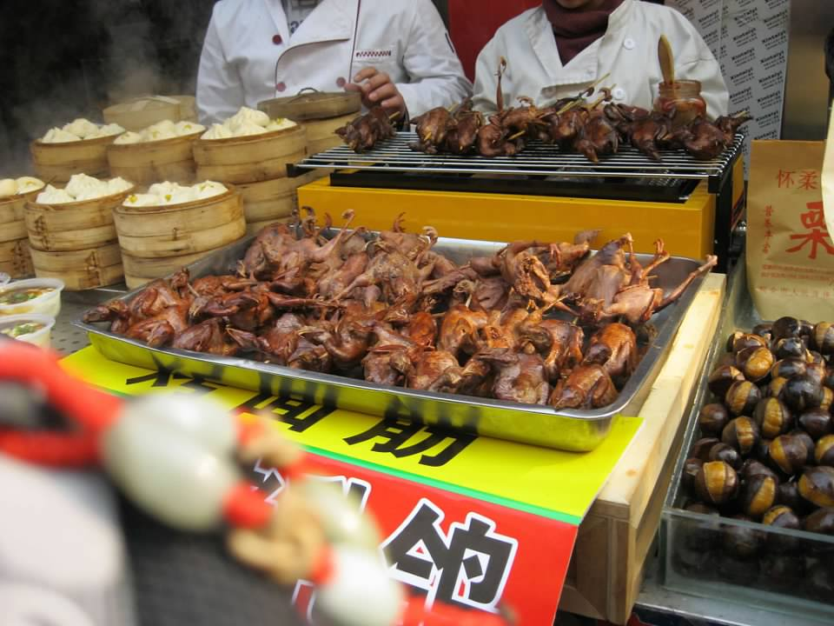
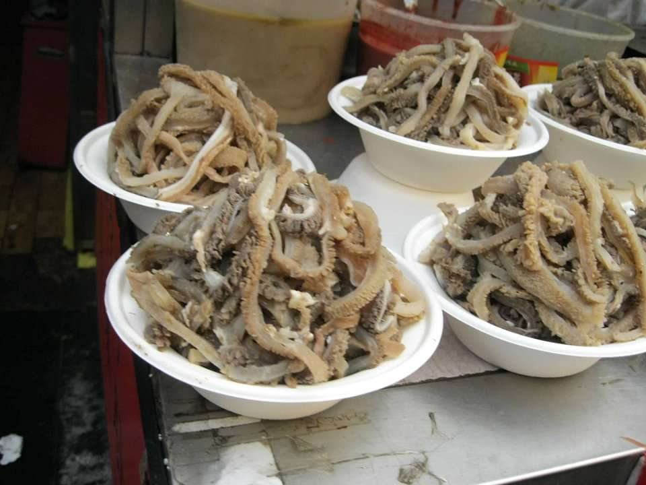

Slide 18
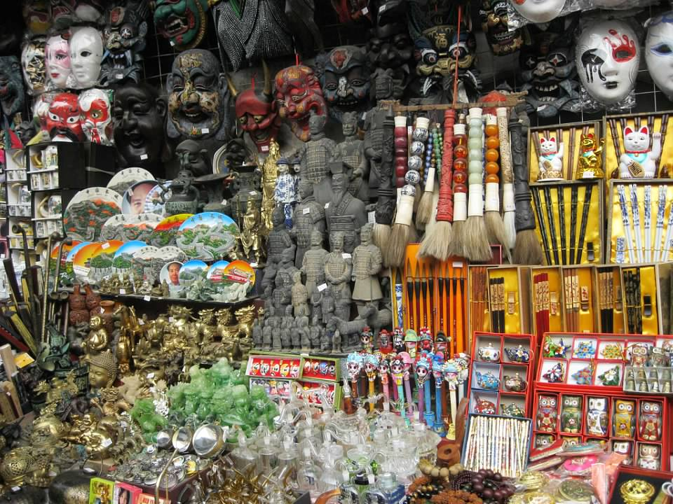

Slide 19
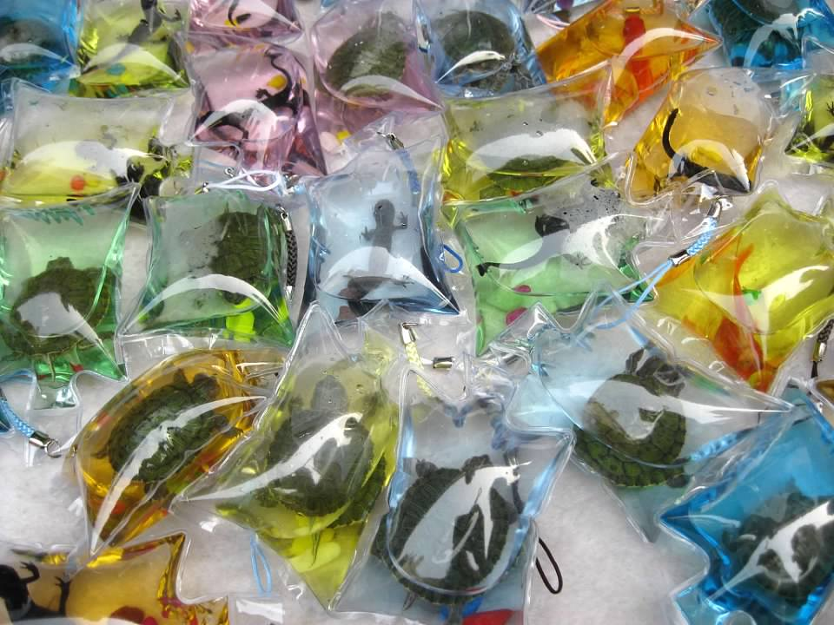

Slide 20
END

