Slide 1
The Byzantine Empire
Chapter 12.1

Slide 2
What caused the Fall of the Roman Empire?
What happens to the people when a civilization vanishes?

Slide 3
Ozymandias
BY PERCY BYSSHE SHELLEY
I met a traveller from an antique land,
Who said—“Two vast and trunkless legs of stone
Stand in the desert. . . . Near them, on the sand,
Half sunk a shattered visage lies, whose frown,
And wrinkled lip, and sneer of cold command,
Tell that its sculptor well those passions read
Which yet survive, stamped on these lifeless things,
The hand that mocked them, and the heart that fed;
And on the pedestal, these words appear:
My name is Ozymandias, King of Kings;
Look on my Works, ye Mighty, and despair!
Nothing beside remains. Round the decay
Of that colossal Wreck, boundless and bare
The lone and level sands stretch far away.”

Slide 4
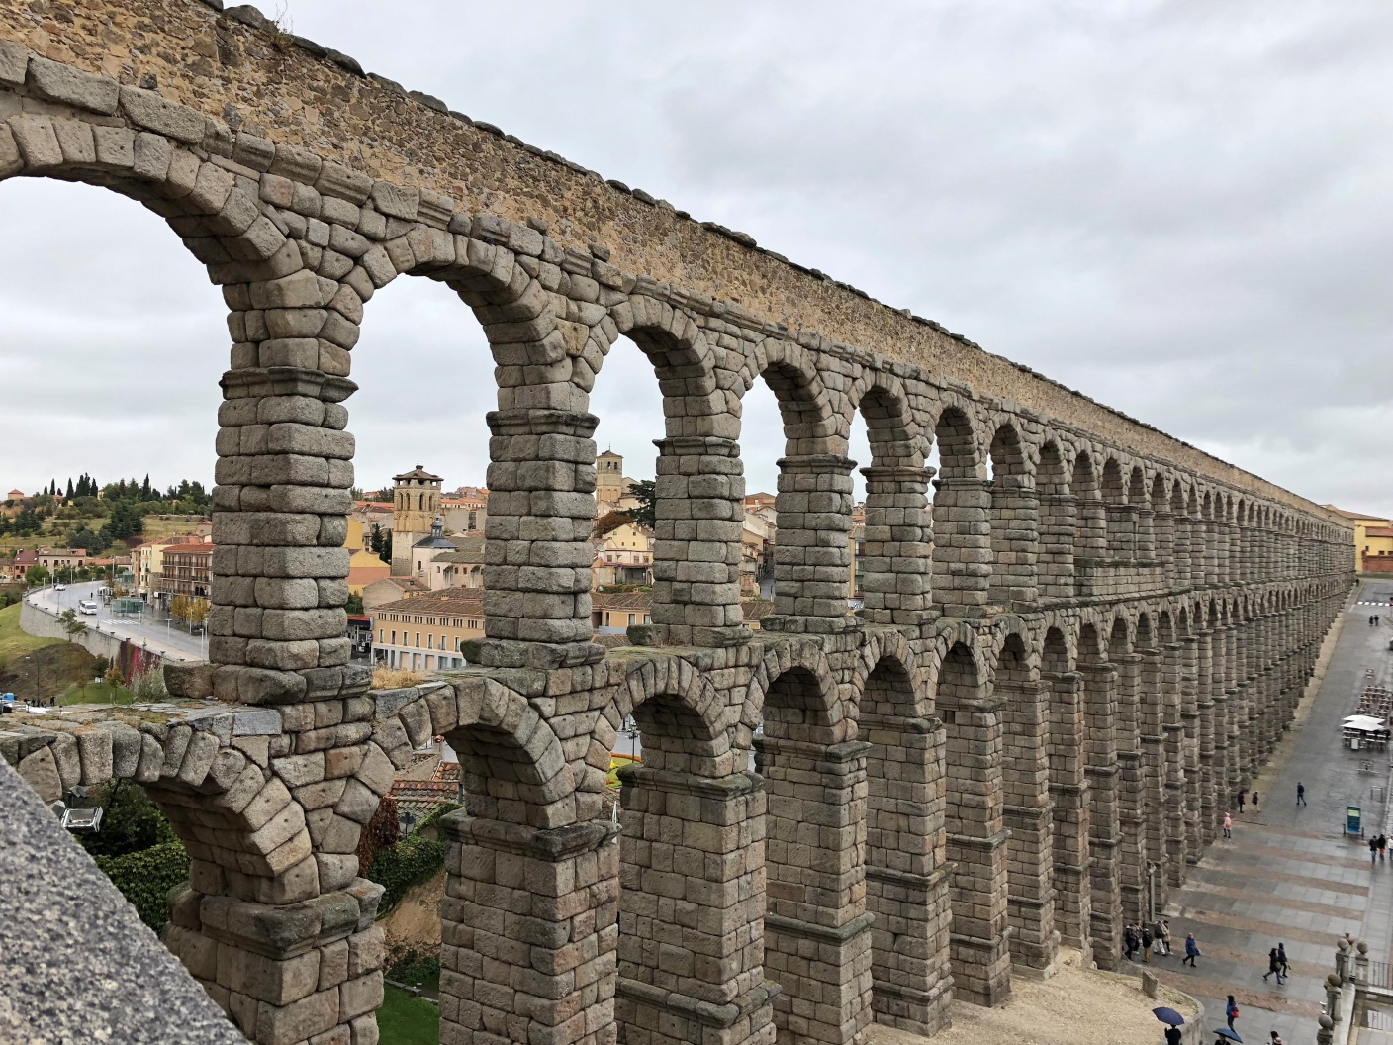

Slide 5
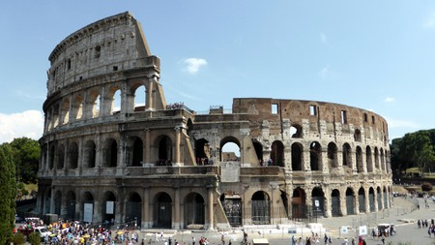

Slide 6
Read Chapter 12.1 with WS
p. 347-352

Slide 7
Emperors Rule in Constantinople
Constantinople (today known as Istanbul) survived the fall of the Roman Empire, and became the capital of the _________________ ________________.
Reasons it outlasted Rome:
  _____________________________________
  _____________________________________
  _____________________________________
Byzantine Empire
Located between two seas
Central location for trade
Heavily fortified walls
Notes:
Byzantine Empire,

Slide 8
Justinian and Theodora
Emperor Justinian reigned from 527-565 CE
  His wife Theodora, formerly an actress, played a huge role as co-advisor.
  She played a large role in promoting rights for women.
  She also kept him from fleeing during the Nika Revolt.
After the rebellion, he was able to rebuild the city and reform the legal system, called ______________________________.
Justinian’s Code

Slide 9
Byzantine Culture
Church and State
  The emperor was seen as the deputy of Jesus Christ on earth, meaning religion and government were linked.
  Even though Byzantines considered themselves to be Romans, ___________________ culture and language grew more and more influent.
Greek

Slide 10
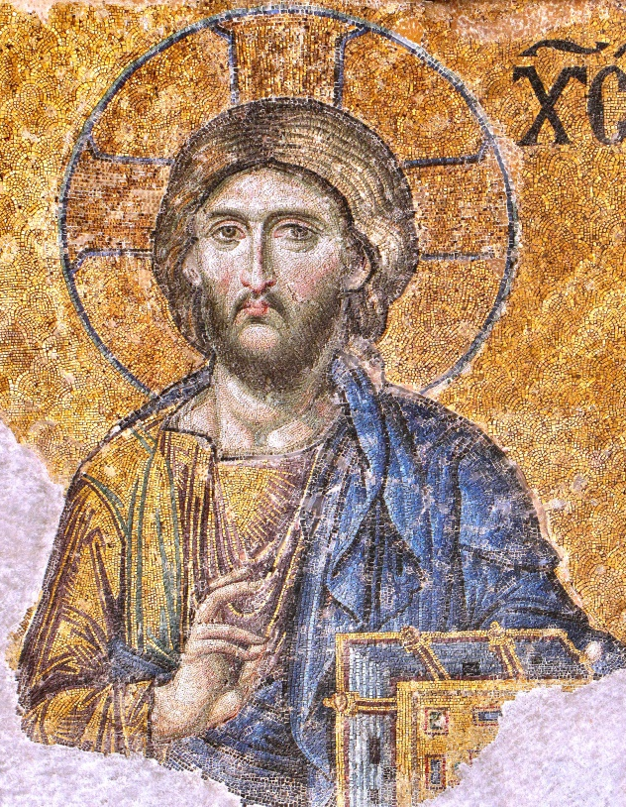
Religion and the Arts
Christianity greatly influenced artistic life of Byzantines
  Art, architecture and literature were all based on religious themes or figures from Bible
Most art was in the form of __________________, which decorated floors, walls, ceilings
mosaics

Slide 11
The Church Splits
icons
Conflicts over the use of ____________ (paintings or sculptures of sacred figures) were seen as the worship of idols.
  There were also issues over whether the clergy could marry and the use of the Greek language instead of Latin.
A further division between the east and west, the Greek Orthodox Church and the Roman Catholic Church led by the ___________ in Rome, led to a schism (split) between the two that still exists today.
pope

Slide 12
The Empire Declines
Islam
Over time, _____________, pressure from migrating tribes, and internal conflict and corruption brought about the Byzantine Empire’s fall.
Continuing strife between the ______________ and the Constantinople government weakened the empire, making it vulnerable to challengers from the outside.
military

Slide 13
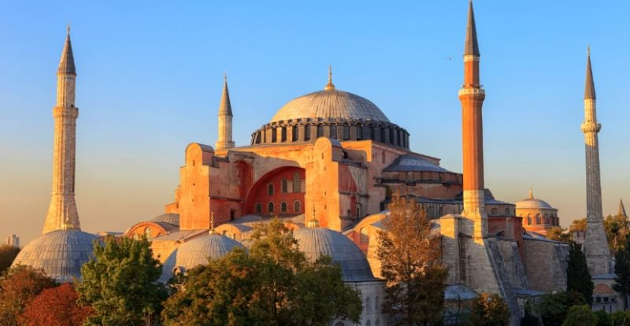
The Hagia Sophia
Notes:
VIDEO: https://www.youtube.com/watch?v=KRPp3jzv1Tw

Slide 14
END

