Slide 1
Chapter 13.2
New Invaders

Slide 2
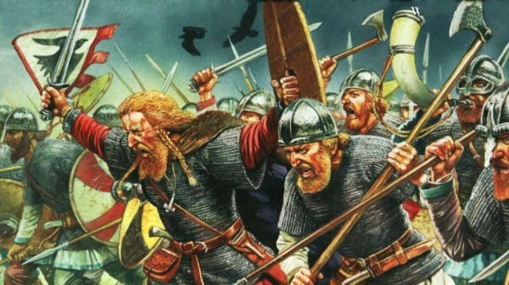
The Vikings
Charlemagne’s peaceful did not last long.
Even before he died, invaders had begun nibbling at the edges of his empire.
Of all the invaders, the fiercest were the Vikings.

Slide 3
The Vikings
Origins of the Vikings
Viking Food Shortage
Vikings came from northern Europe
Lived in Scandinavia
Society rural, agricultural
Most worked as fishers, farmers
Though sea provided plenty of fish, soil not fertile
Farmers had trouble growing enough grain
Food shortages common problem

Slide 4
Vikings Raids
Viking leaders looked for new sources of food, wealth
Decided to take what they needed from others
Viking raids began

Slide 5
Viking Raids
Sailing Skills
Vikings superb ship builders and sailors
Ships capable of withstanding heavy ocean waves; crews as many as 100
Skills at navigation allowed crossing great expanses of ocean
First Targets
First targets of raids England, northern France
Later Vikings began raiding places farther from homeland
Even inland locations like Paris, Aachen unsafe

Slide 6
Viking Raids
Little Time
People lived in fear, had no warning that Vikings were coming
Fast-moving ships approached target quickly
Vikings killed, captured defenders; took what they could find, sailed away
Favorite Target
Among favorite Viking targets, monasteries
Monks not warriors, monasteries easy to plunder
Fine treasures, jeweled crosses, golden candlesticks stolen
Vikings not Christians, had no problems stealing religious items

Slide 7
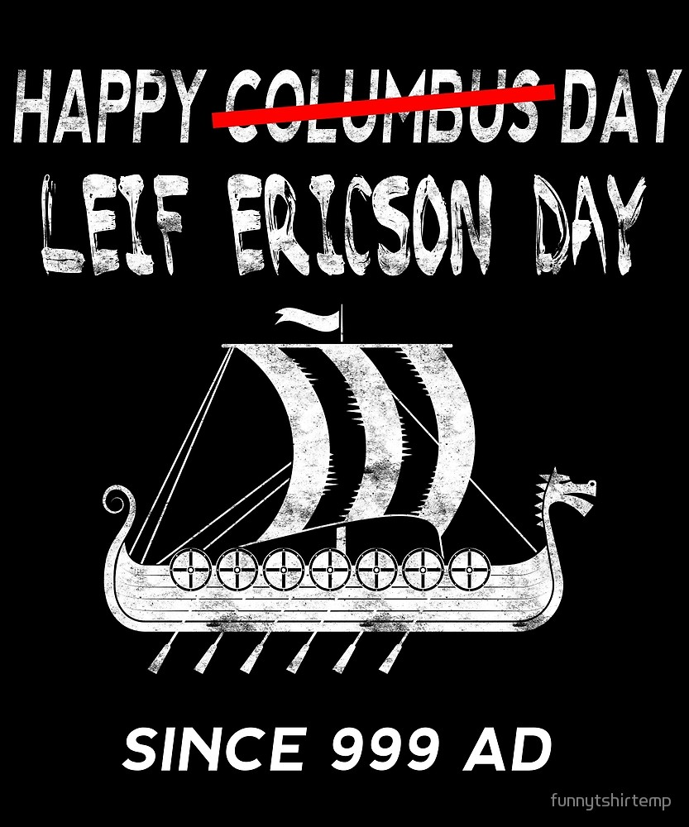
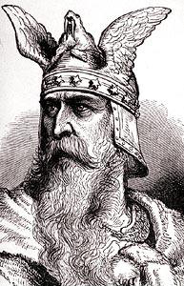
Viking Settlements
Not all Vikings who left Scandinavia raiders, some explorers
One place settled by Vikings, Iceland; first arrived late 700s
Viking society thrived there for centuries, longer than in Europe
982, Viking explorers reached Greenland
100 years later, Leif Eriksson reached North America

Slide 8
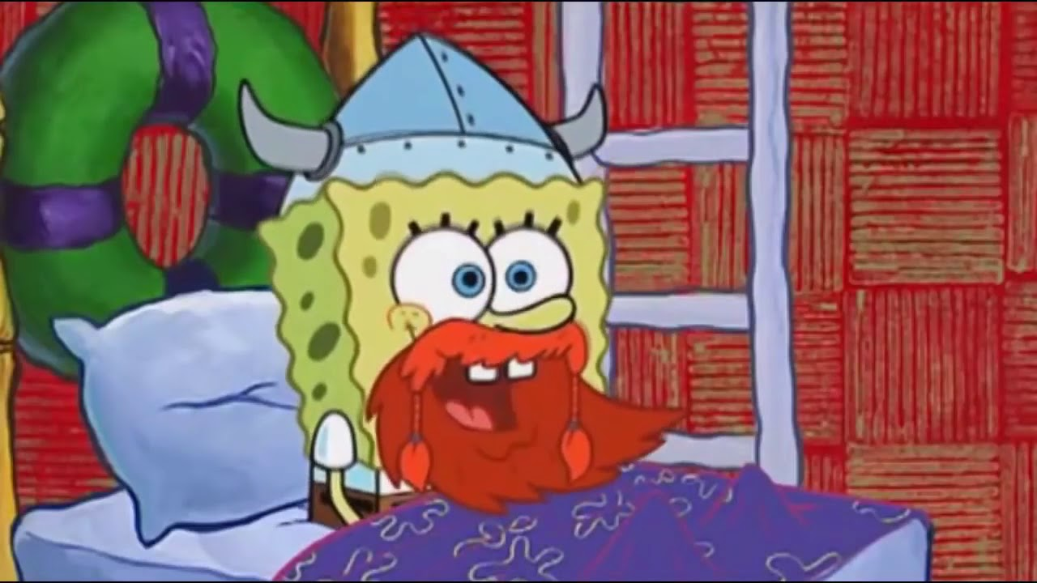
Notes:
VIDEO: https://www.youtube.com/watch?v=mhyZSOireR8

Slide 9
Normandy
Viking warriors also settled in northern France
Led by chief named Rollo, attacked France many times
King of France made deal with Rollo
Rollo to stop raids, defend Frankish lands against other Vikings
King to give Rollo land
Rollo accepted, area became known as Normandy, land of Northmen

Slide 10
The Magyars
Nomads
Vikings terrorized northern, western Europe; Magyars invaded from east
Magyars nomads from central Asia who settled in what is now Hungary
Fierce warriors like Vikings
Not sailors, skilled riders who outmaneuvered opponents on horseback
Planned raids carefully, attacking smaller settlements
Raids
Raided eastern France, Germany, northern Italy, western Byzantine Empire
Eventually gave up nomadic ways, but lost battle advantage of running from opposing armies
Mid-900s, German king Otto the Great crushed Magyar army, ending raids

Slide 11
The Muslims first came to Europe in large numbers as conquerors
Muslim Spain
711, Muslim army from North Africa crossed Strait of Gibraltar, conquered Spain
Ruled Iberian Peninsula more than 700 years
Capital city, Cordoba, one of wealthiest, most culturally advanced cities of medieval world
Muslim Spain land of tolerance
France, Italy
732, Muslims swept into France, stopped short by Charles Martel, Charlemagne’s grandfather
800s, 900s, Muslim leaders ordered small, fast raids against cities, towns in southern France, Italy
Raided Rome, destroyed ancient churches

Slide 12
Blocking Trade
Muslim fleets blocked Byzantine trade in Mediterranean
Muslim pirates looted ships, sold crews into slavery
Cut off Italy from trade with eastern allies
Pope turned to Franks for protection
Balance of power in western Europe shifted because of this

Slide 13
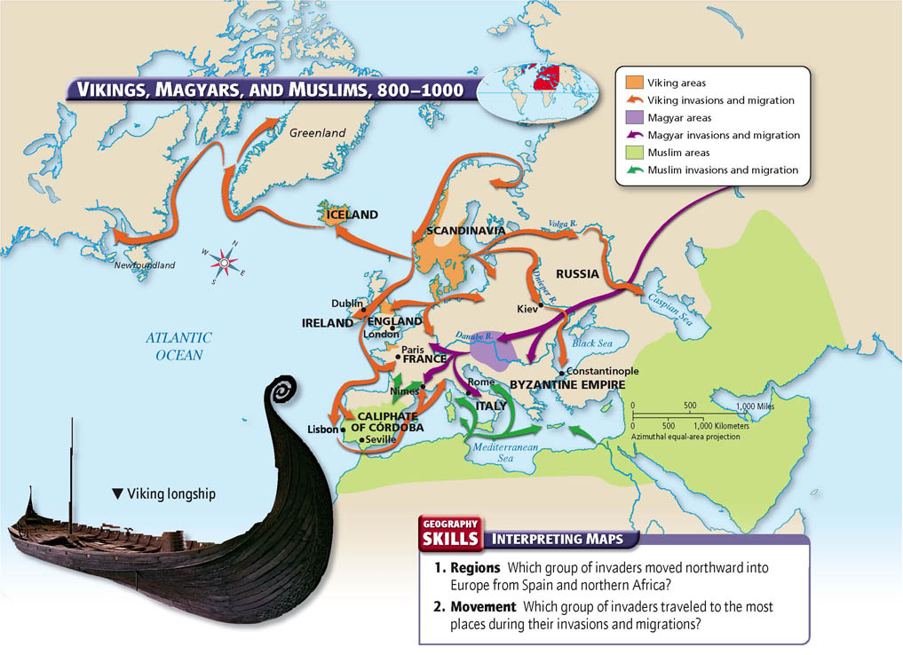

Slide 14
END

