Slide 1
Chapter 13.4
The Growth of Monarchies

Slide 2
Response to Feudalism Activity
Notes:
VIDEO (Monty Python feudalism clip): https://www.youtube.com/watch?v=ZtYU87QNjPw

Slide 3
The English Monarchy
England has had many invaders over the years
43 AD
Rome
400s AD
Angles
Saxons
Jutes
800s AD
Vikings

Slide 4
In the 800s, Alfred the Great drove off the Vikings and unified the seven kingdoms of England.
His descendants ruled for the next two centuries.
And then…

Slide 5
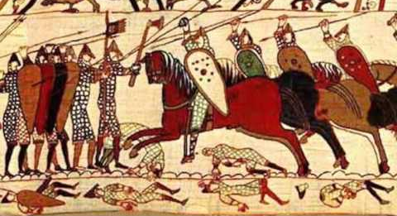
In 1066, the king Edward the Confessor died without an heir, so two men claimed the throne
Harold – Anglo-Saxon nobleman from England
William – duke of Normandy from France
What happened?
Notes:
VIDEO (history teachers William video: https://www.youtube.com/watch?v=bQ8A5gRe_Dw

Slide 6
William decided to take crown by force; he gathered an army and sailed for England where Harold met him
Two armies fought in Battle of Hastings; William won
He was crowned King William I of England, but he was known as William the Conqueror

Slide 7
William stronger king than Anglo-Saxon rulers
He claimed all English land as personal property
He divided land into fiefs for his Norman soldiers
He created new nobility, all owed loyalty to king.
He brought French culture to the Anglo-Saxons

Slide 8
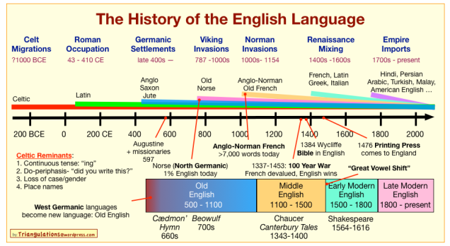
Impact of William on us today
Notes:
VIDEO (Light History of the English Language): https://mvcc-video.mvcc.edu/app/plugin/embed.aspx?playlistEmbed=true&isResponsive=true&isNewPluginEmbed=true&displayTitle=true&useIFrame=true&hideControls=true&destinationID=Vv_blj7BPkqZE6BOS-ZC5g&contentID=8VxWkD4710K7754xdxOaWg&isResponsive=true&orderBy=videoDate&orderByDirection=desc&pageIndex=1&pageSize=10

Slide 9
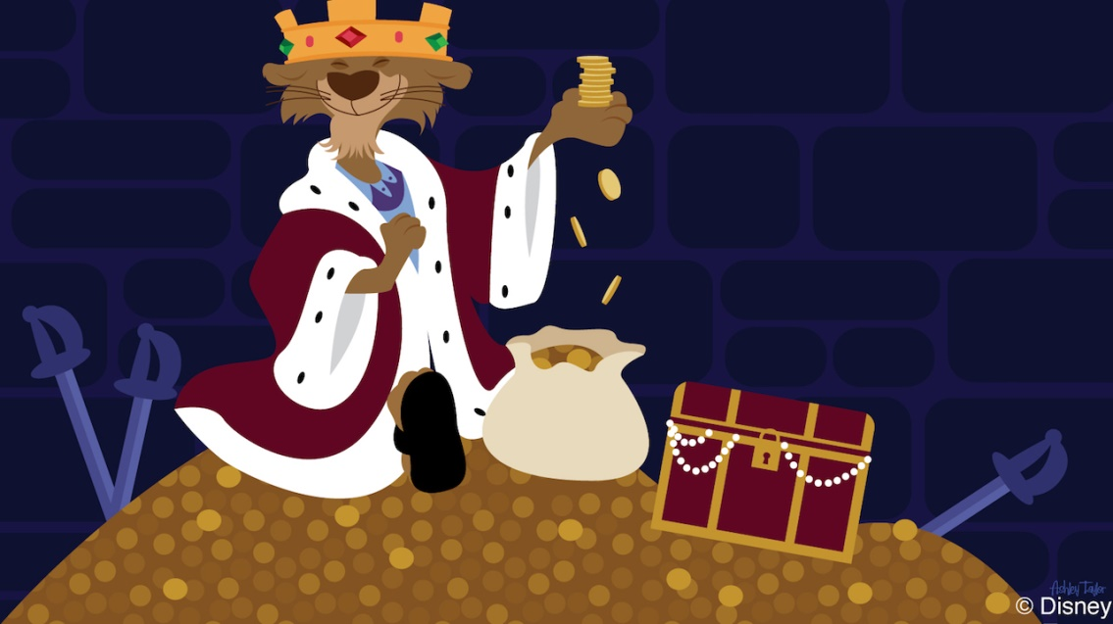
Magna Carta
In 1215, King John was short on money (for reasons relating to the 2nd photo, to be explained in 14.1)
He tried to tax the nobility, but they weren’t having it.

Slide 10
The nobles rebelled and forced John to accept a document outlying their rights.
This was called the Magna Carta
It limited the king’s power
It suggested that the king was not above the law
It ended the king’s ability to arrest and punish people without cause
It said the king could not take property without legal procedures
Can you guess where a copy of it is currently held…
Can you guess why?
Notes:
VIDEO (horrible histories rap battle Magna Carta): https://www.youtube.com/watch?v=F_5My8XH-n0
VIDEO (horrible histories song Magna Carta): https://www.youtube.com/watch?v=XTWQzF1027I&t=3s

Slide 11
Parliament
The nobles weren’t satisfied that Magna Carta did enough
The king had to meet with members of the nobility, clergy, and middle class to discuss key issues and make laws
It was called Parliament, and it still exists in England today
Except members are elected
And the “king” has no real power
Like… none
At all…
This strengthened the relationship between the monarch and the people

Slide 12
Summarize
How did Magna Carta and Parliament change the English monarchy?
Discuss your answer with one of your neighbors
reduced the king's power
formed a council (Parliament) that would create new taxes and advise the king on lawmaking

Slide 13
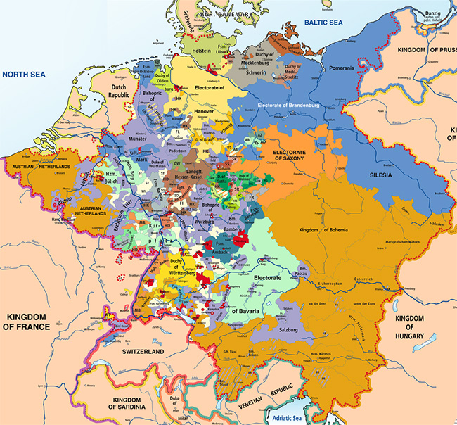
Other European Monarchies
France
Did not expand much after Charlemagne and constantly fought with the English
Germany
Split away from France and into several small states
Doesn’t effectivity get unified into the Germany we know today until the late 1800s

Slide 14
Spain and Portugal
The Iberian Peninsula had been conquered by the Muslims
Christians lived in the northern border, near France
A civil war broke out between the Moorish (Muslim) leadership
The Christians attacked
This is known as the Reconquista, the attempt to retake the territory.

Slide 15
Analyze
How did rulers in France, the Holy Roman Empire, and Spain gain power?
Discuss your answer with a classmate near you
by acquiring new land and territories through alliances, marriage, and conquest

Slide 16
Assignment
Turn to page 396-397 in your textbook
We will read the Perspectives on the Magna Carta together
After each one, you will answer the questions at the bottom of p. 397 on a separate sheet of paper
Your responses will be for a grade.

Slide 17
End

