Slide 1
Chapter 14 – The High Middle Ages
Section 1: The Crusades

Slide 2
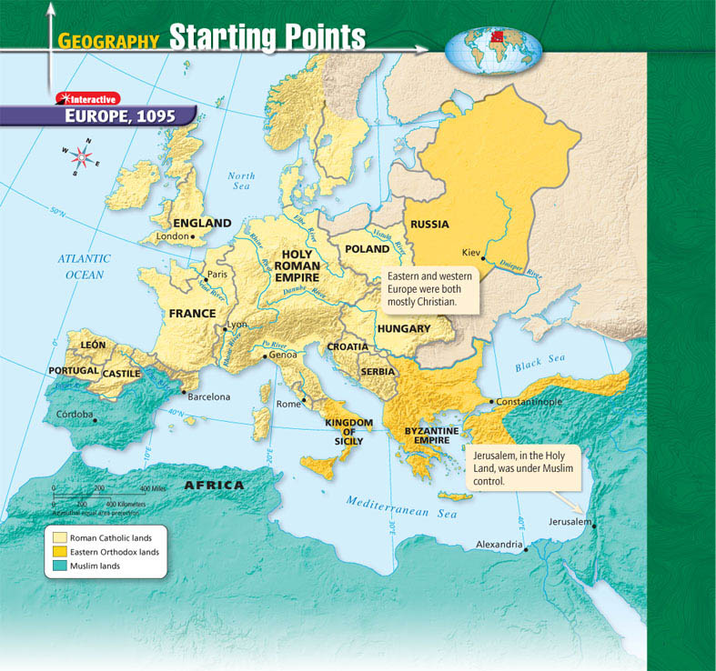

Slide 3
Launching the Crusades
Crusades defined: a series of religious wars during the Middle Ages
Goal of the Crusades
To take Jerusalem, the Holy Land, away from Muslims
Jerusalem is where
The Holy Temple of Jews is located
Jesus crucified, buried, and rose after 3 days
He would return again
Therefore, it was vital to Christians that they controlled the city

Slide 4
Who controlled the Holy Land?
Muslims
North African Muslims, Fatimids, took over Jerusalem in the late 1000s
Turkish Muslims took control of Persia and other lands, and persecuted Christians visiting region

Slide 5
Pope Urban II
In 1071, the emperor of the Byzantine Empire asked the current pope for help
Even though the church had just split in 1054…
Break ups are weird, yo.
That pope, was Urban II
He agreed
Why?

Slide 6
The First Crusade
Reasons he agreed
Urban II wanted to increase his own power
In-fighting in Europe
Who he got to go & why
Knights
Code of chivalry
Earthly level up
Afterlife level up (a.k.a. Indulgences)
Merchants
Monopolize ports
Take control of Muslim markets
Peasants
Eager to fight

Slide 7
Peasants vs. Knights
Peasants
Knights
Unskilled
Answered Pope’s call
Eager to fight non-Christians in Holy Land
On the way attacked and slaughtered German Jews despite protests
Fell to Seljuk Turkish army at Jerusalem
Better trained in warfare than peasants, but unprepared for hardship of journey
Traveled three years
Siege of Jerusalem victory for Crusaders, disaster for city
Renamed four states in Holy Land, intended to be strongholds against future Muslim conquests

Slide 8
Crusades II, the Sequel
Muslims began retaking lands lost in First Crusade
In 1144, they took the city of Edessa, capital of one Crusader state
In 1147, European leaders called for Second Crusade
To summarize… it was an utter failure

Slide 9
Crusades III, The Reboot
Cast of characters:
Pope Urban III
We Three Kings
Richard the Lion-hearted of England
Philip Augustus of France
Frederick Barbarossa of Germany
Salah ad-Din (a.k.a. Saladin)
Declared himself sultan, and successfully drove the Christians out of Jerusalem

Slide 10
Most of this takes place between Richard and Saladin.
The two men respected each other as military leaders and gentlemen
They tried for peace, proposing the marriage of Richard’s sister and Saladin's brother
This didn’t happen because of religious difference.
In the end, Richard was unsuccessful and had to return home.

Slide 11
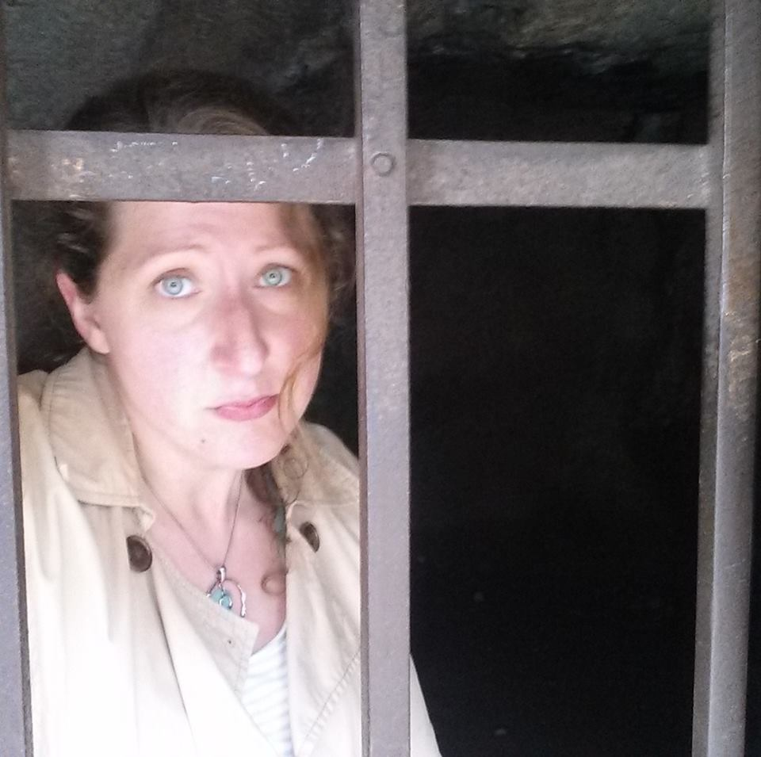
What was this about, Ms. Hannawi?
That photo was taken in the ruins of Durnstein Castle where in 1192, King Richard was held captive their after he insulted the Duke of Austria during the Third Crusade.
Pope Celestine III intervened and had Richard moved elsewhere.
The fee for this and Richard’s involvement in the Crusades, is part of the reason for his brother raising taxes in England and the basis of the legend of Robin Hood!

Slide 12
The Crusades: The Next Generation
There were NINE total Crusades between 1096 and 1291 AD
Only the first was successful
One in 1212 was called the Children’s Crusade
Because children + swords = victory?
Actually made up of 20,000 children, adolescents, and adults
Result: complete failure
Only a few made it home
Those who weren’t killed were believed to have been sold into slavery

Slide 13
Effects of the Crusades
Economic Changes
Political Changes
Crusades increased and enhanced existing trade
Returning Crusaders brought more goods, spices, & textiles to Europe
Crusades led to deaths of many knights & nobles
Lands left vulnerable
Other ambitious nobles took control of unoccupied lands
As a result, nobles had more power and influence in Europe

Slide 14
Social Changes
Relations between the Christians and the Muslims
Relations between the Christians and the Jews
How has that impacted us today?

Slide 15
END

