Slide 1
Chapter 14 – America and World War II
Section 3 – Life on the Home Front

Slide 2
Women and Minorities Gain Ground
Several jobs became available to help the war effort. The ___________________ ends.
Because of the economy, people believed married women should not take jobs that could go to men who supported families. Because of the war, several industrial jobs were available. To inspire women, _____________________________ became a popular character for propaganda.
Great Depression
Rosie the Riveter

Slide 3
A Nation on the Move
Great Migration
A second __________________________ occurs as African Americans move from the South to obtain factory jobs. Racial violence again occurs.
One incident: a fight in __________________ on Belle Isle between African American and white teenage girls. 34 total killed.
Detroit

Slide 4
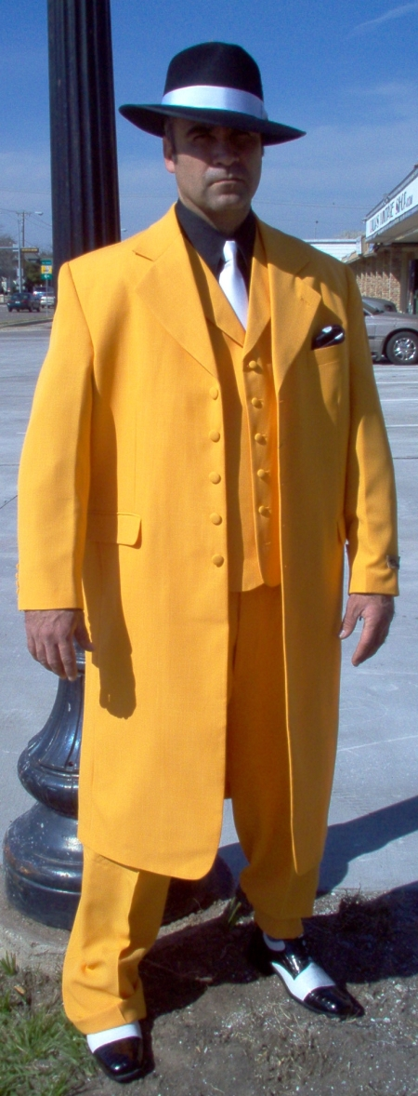
Zoot Suit Riots
Mexican Americans also face _____________.
People were trying to conserve fabric, but the “____________________” were excessive and baggy – unpatriotic.
Reports that sailors had been attacked by zoot-suiters led soldiers to attack Mexican American neighborhoods in Los Angeles. The violence continued for several days. L.A. responded by banning zoot suits.
racism
zoot suits

Slide 5
Japanese American Relocation
After Pearl Harbor, many Americans become angry at _____________________________.
Fears and rumors of spies increased these fears, causing government officials to create __________________________________, where those of Japanese descent were forced to move to, leaving homes and businesses behind.
Japanese Americans
internment camps

Slide 6
Daily Life in Wartime
Wages and prices are stabilized, and inflation is kept over control.
Rationing
Victory gardens
Scrap drives
Paying for the war
Taxes raised
Liberty bonds

Slide 7
14.3
Which is NOT true of the U.S. home-front during WWII:
Rosie the Riveter was a term to describe female industrial workers
There was no military draft
The U.S. interned thousands of Japanese-Americans
The U.S. rationed gasoline and meat

Slide 8
14.3
As a result of a Presidential Order allowing the military to declare any part of the United States to be a military zone, _________.
many areas of the American West became off limits to civilians
many Japanese-Americans were moved to internment camps
much of the Nevada desert became a testing ground
many military installations sprang up along America’s West coast

Slide 9
14.3
During World War II, the goal of rationing was to ___.
Limit consumer goods and preserve them for the military
Starve Americans into submission
Re-elect the President of the United States
Defeat communism

Slide 10
14.1
Which industry contributed the most to the production of American war materials during WWII?
Film industry
Automotive industry
Fishing industry
Computer industry

Slide 11
End

