Slide 1
Chapter 14.4
Challenges of the Late Middle Ages
Notes:
VIDEO (Danse Macabre): https://www.youtube.com/watch?v=YyknBTm_YyM

Slide 2
Religious Crises
The High Middle Ages saw an increase in heresy
Beliefs that opposed the official teachings of the church
Inquisitions began
Special judges would determine whether accused people were innocent or guilty
Notes:
VIDEO (MP witch scene): https://www.youtube.com/watch?v=zrzMhU_4m-g

Slide 3
Wars and Conflict
Hundred Year’s War
In 1337, the English and French fought for the throne of France
The English were very successful – King Henry V pushed to the gates of Paris
In 1453, the French were able to push the English back and end the war

Slide 4
Joan of Arc
Joan was only 17 when she led the French forces into battle
She managed to rally the French troops, who had been morally defeated by their losses
Soldiers followed her because she claimed to be sent by saints
Eventually Joan was captured and burnt at the stake, making her a martyr

Slide 5
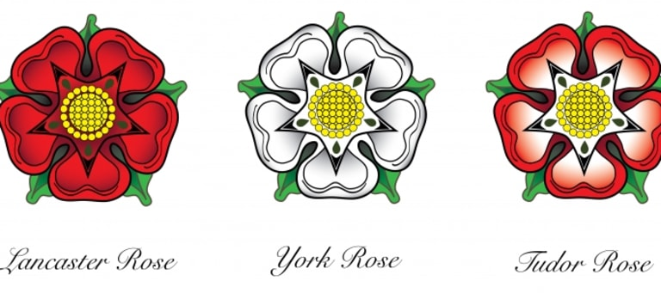
War of the Roses
In 1461, Lancasters & Yorks fought for the throne of England
The Yorks succeed at first, until the king dies and his heirs disappear.
Richard III is crowned king, but his reign is short lived.
Tudor Henry VII becomes king, both Lancasters & Yorks lose

Slide 6
Black Death
Brought to Europe from Asia via the Silk Road and merchant ships
Notes:
VIDEO (Holla Black Death): https://www.youtube.com/watch?v=rZy6XilXDZQ

Slide 7
Black Death
It spread rapidly
Almost all of Europe was touched by Black Death by 1351
Notes:
VIDEO (Holla Black Death): https://www.youtube.com/watch?v=rZy6XilXDZQ

Slide 9
Black Death Effects
1/3 to 1/2 the population died
Innocents blamed & killed
Jews
Women
Cats
Scientific advancements
Collapse of the feudal / manorial system
Notes:
VIDEO (MP Bring out your dead): https://www.youtube.com/watch?v=Jdf5EXo6I68

Slide 10
END

