Slide 1
Chapter 16.3
New Patterns of Trade

Slide 2
The Columbian Exchange
What is the Columbian Exchange??
The widespread exchange of plants, animals, and disease
Who exchanged?
Native Americans & Europeans
What was exchanged?
Let me show you!

Slide 4
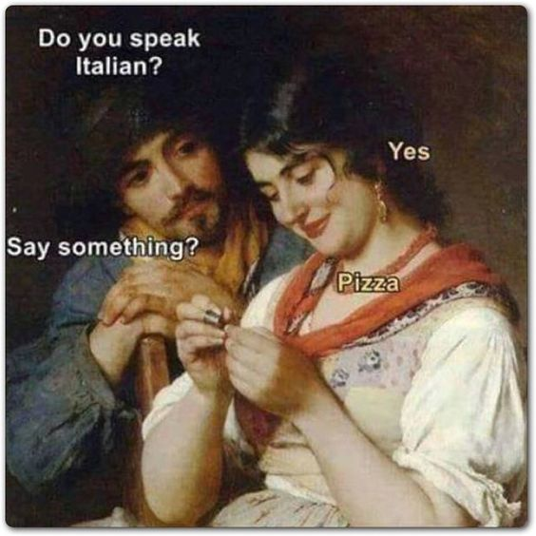
Activity

Slide 5
Notes:
VIDEO (The history of chocolate): https://www.youtube.com/watch?v=ibjUpk9Iagk

Slide 6
END Part 1
To be continued…

Slide 7
Aside from plants and animals, what else was shared via the Columbian Exchange?
Ideas?
Religious beliefs?
DISEASES
Notes:
VIDEO (Crash Course: The Columbian Exchange): https://www.youtube.com/watch?v=HQPA5oNpfM4

Slide 8
Assignment:
Part 1: Read Chapter 16.3 and answer the questions
Part 2: Follow the directions to create two comics based on mercantilism

Slide 9
Political Cartoons

Slide 10
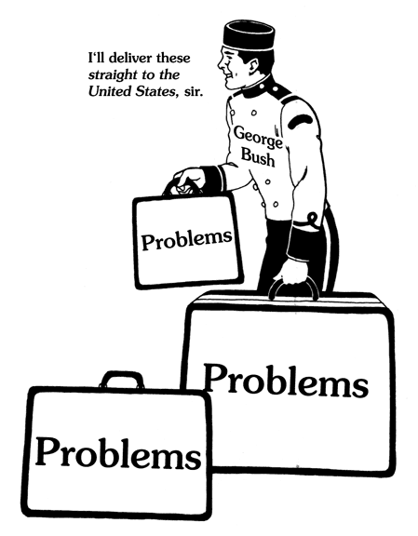

Slide 11
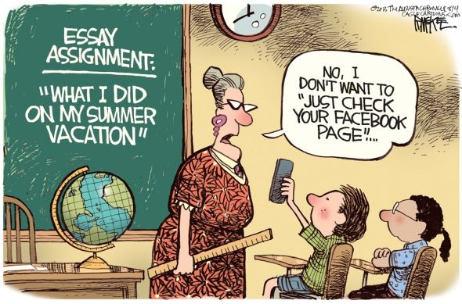

Slide 12
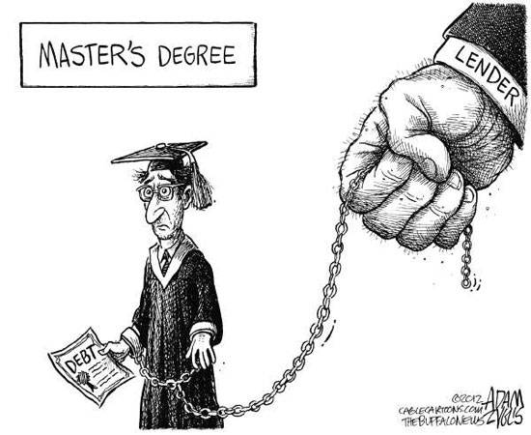

Slide 13
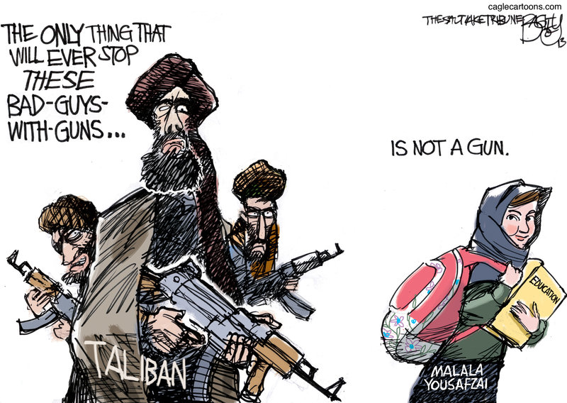

Slide 14
END Part 2

