Slide 1
Chapter 18:
The Monarchs of Europe

Slide 2
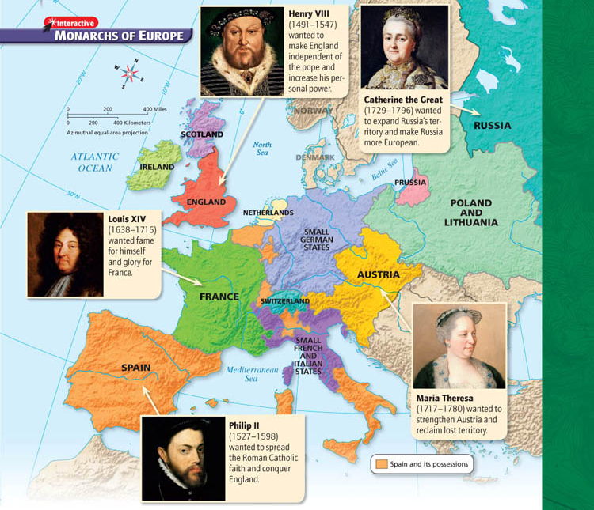

Slide 3
Section 1: The Power of Spain

Slide 4
The King Becomes Emperor
Absolute monarchs
ruler whose power not limited
by having to consult with nobles, common people or their representatives
believed they ruled by divine right
Monarchs received power from God, must not be challenged

Slide 5
In 1516, teenager Charles Hapsburg became King of Spain.
Though inexperienced at ruling, his ancient & powerful family name helped him gain power and influence
In 1519, a new position became available: Holy Roman Empire

Slide 6
Emperor Charles V
Charles borrowed money to buy votes
He was successful and became Holy Roman Emperor Charles V
As King of Spain, he already had control of territories in Belgium and the Netherlands, along with colonies in the Americas
Now, his holdings expanded to parts of Italy, Austria, various German states
So vast ‘the sun never set” over it

Slide 7
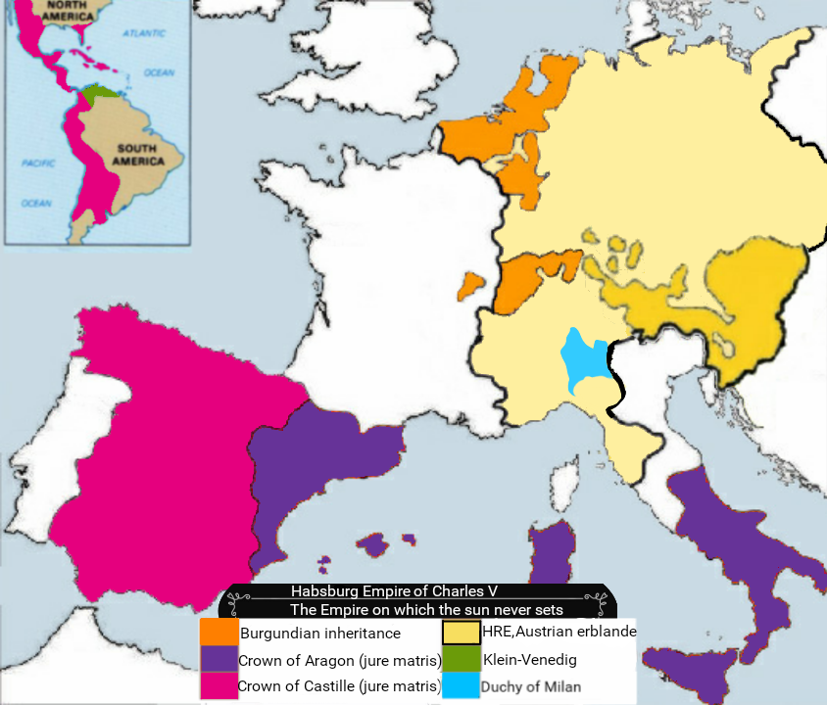

Slide 8
Enemies Everywhere
Peace of Augsburg
Controlling this much territory wasn’t easy
He faced threats from all sides
Ottoman Turks
French
Rebellious German princes
And the biggest threat to the Catholic leader… Protestants
Charles confronted Protestant leader Martin Luther directly, but Protestants continued to fight
After years of warfare, Charles V had to sign Peace of Augsburg
This gave each German prince right to decide if his state would be Catholic or Protestant

Slide 9
Success in Americas
Charles V had far more successful in the Americas than in Europe
Spanish explorers claimed much of the Americas for Spain
Hernán Cortés, who conquered Aztec empire
Francisco de Coronado, who explored American Southwest region
Silver and gold flowed from American colonies making Spain fabulously wealthy

Slide 10
Dividing the Empire
1556, Charles V gave up the throne, splitting the empire between his brother and his son
His brother took over Hapsburg holdings in Austria
His son, Philip II, ruled Spain, Netherlands, Sicily, & Spain’s American colonies

Slide 11
Spain under Philip II
King Philip II devout Catholic
His marriage to Queen Mary I of England was a chance to spread Catholicism
Remember her nickname… Bloody Mary!
She died without an heir, so the throne of England went to her sister

Slide 12
Spain and England
The Dutch refused to declare allegiance to Philip and revolted against Spain
As fellow Protestants, England sent aid to Dutch rebels infuriating Philip
Philip also worried about English attacks on his ships
England’s Queen Elizabeth I allowed ship captains to attack Spanish treasure ships, steal gold, silver for England
King Philip II wanted to stop England from raiding ships and return England to Catholic Church, so he decided to invade England

Slide 13
Philip ordered navy to assemble great fleet, the Spanish Armada
Totaled about 130 ships, 20,000 soldiers, sailors
1588, invincible fleet sailed into English channel
Queen Elizabeth I rallied troops and prepared for attack
Main plot of the movie →

Slide 14
Section 3: Monarchy in England

Slide 15
The Tudors and Parliament
Unlike the Spanish and French, Henry VIII could not rule with absolute monarchy
He had to work with Parliament to fulfill his goals
Remember, Henry got Parliament to break from the Catholic Church and let him have his divorce
After the deaths of King Henry, his son, and daughter Mary, his and Anne of Boleyn's daughter Elizabeth was crowned Queen of England

Slide 16
Elizabeth was pressured into marriage by Parliament, but she refused
A husband would mean a king, and she refused to give up her power.
Instead, she vowed to remain unmarried, thus her nickname “The Virgin Queen”

Slide 17
A major reason for Elizabeth’s good relationship with Parliament, her willingness to let members speak minds without fear of punishment
Elizabeth reigned for 45 years
She was succeeded by James, the son of her cousin Mary, Queen of Scots.
His reign unified England and Scotland

Slide 18
TO BE CONTINUED
After we watch Elizabeth: The Golden Age

Slide 19
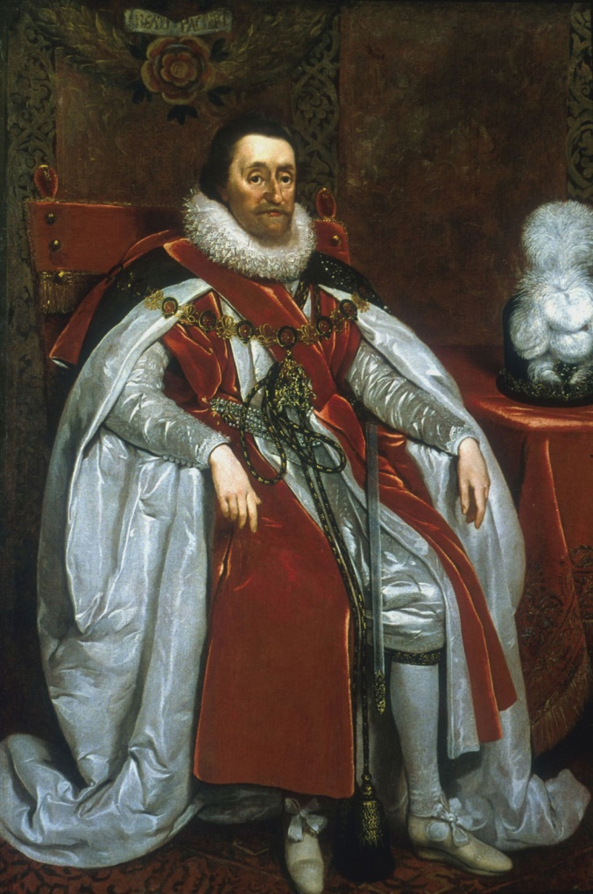
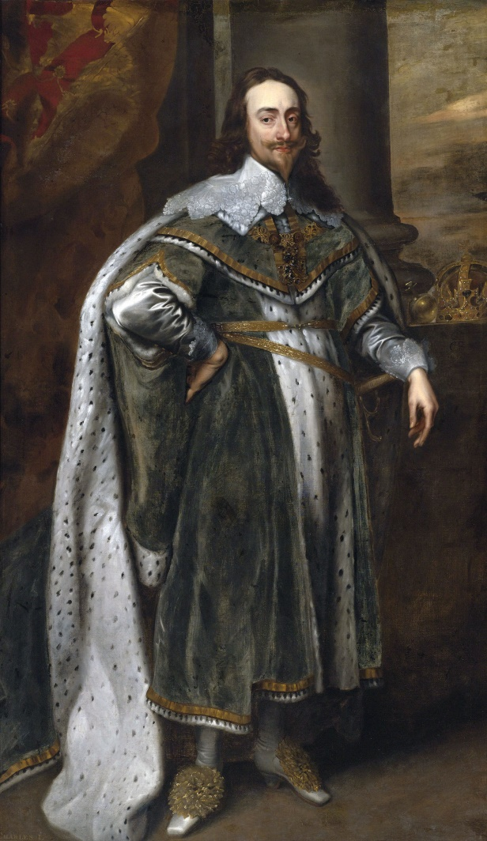
The Stuarts and Parliament
The Stuart kings James I and his son Charles I both wanted to reign as absolute monarchs
Parliament had other ideas

Slide 20
The Stuarts and Parliament
The radical Puritan group in Parliament moved to abolish appointment of bishops in Anglican Church
Charles, who as king held power over the church, was outraged and decided to arrest Puritan leaders for treason
He led troops into House of Commons, but men had already escaped
Charles had tipped his hand on intentions to take back power, so some members of Parliament decided to rise up against king
Charles I called for support of English people and in 1642, the English Civil War began
This ended… not great

Slide 22
Oliver Cromwell
After the death of Charles, England becomes a commonwealth and appoints Oliver Cromwell “Lord Protector of England, Scotland, and Ireland”
Prime Minster for life?
After he died, his son took over and was terrible, so he gets replaced.
Since this all gets very confusing…

Slide 23
Notes:
VIDEO (English Civil War: Crash Course European History #14): https://www.youtube.com/watch?v=dyk3bI_Y68Y

Slide 24
END

