Slide 1
Enlightenment and Revolution
Chapter 19

Slide 2
The Scientific Revolution
Section 1

Slide 3
Scientific Method

Slide 4
Copernicus
Found geocentric theory of movement of sun, moon, planets not accurate
Concluded sun, not earth, was near center of solar system
Heliocentric theory, earth revolves around sun

Slide 5
Isaac Newton
English scientist who brought together astronomy, physics, math
Wondered about gravity and whether it affected objects in universe the way it did on earth
Keeps planets in orbit

Slide 6
Galileo
Supported the Copernican theory of the solar system
This brought him into direct conflict with the church
He stood trial and had to agree to not use the theory in his work
Placed under house arrest for the remainder of his life

Slide 7
The Enlightenment
Section 2

Slide 8
Thomas Hobbes
English philosopher
Argued that because people were selfish and greedy, government was needed to impose order
The best government was an absolute monarchy

Slide 9
John Locke
English philosopher
Argued that people were born equal and had natural rights of life, liberty, and property
Said government should only exist to protect people’s rights
Limited government chosen by the governed
Notes:
VIDEO (biography): https://www.youtube.com/watch?v=b2NnEfhQ15M

Slide 10
Jean-Jacques Rousseau
French philosopher
Believed
That people were basically born good
That government should exist for the common good, not just a wealthy few
That individuals should be willing to give up some freedoms for the community

Slide 11
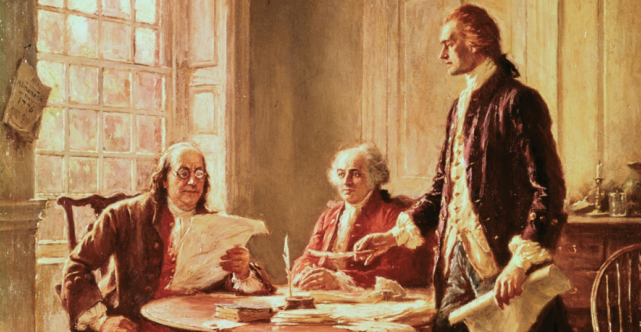
Enlightenment Ideas Spread
These opinions spread quickly
18th century viral
Some monarchs tried to incorporate ideas
Known as “enlightened despots”
It wasn’t long before the ideas made their way to the European colonies, causing…

Slide 12
End

