Slide 1
Chapter 20: The French Revolution
Section 1 – The Revolution Begins

Slide 2
Causes of the Revolution
The Revolution Begins: Part 1

Slide 3
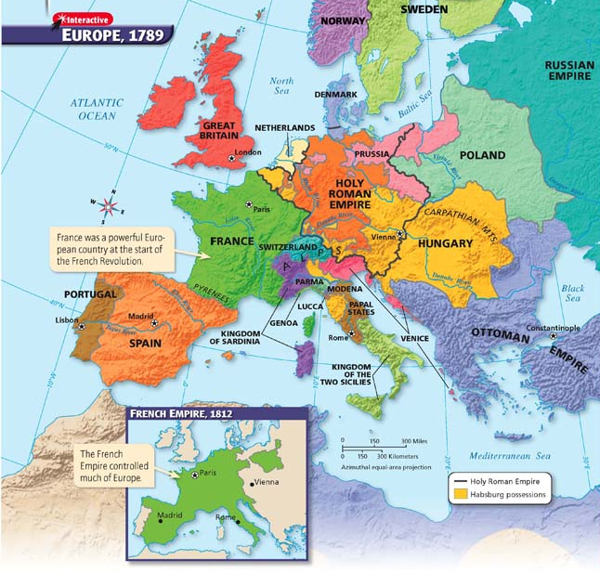

Slide 4
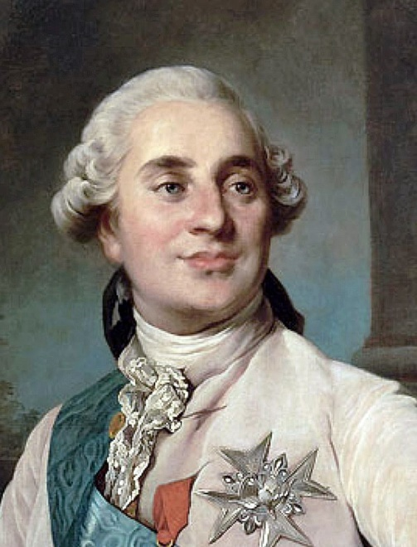
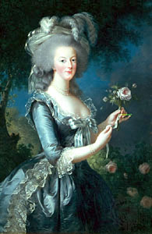
Causes of the Revolution
Long-standing resentments against the monarchy
Inequalities in society
Existing social and political structure
Called the Old Order, or ancient régime
King at the top and estates under him
King Louis XVI, shy and indecisive
Unpopular, self-indulgent queen, Marie-Antoinette
Rest of French society divided into three classes, called estates

Slide 5
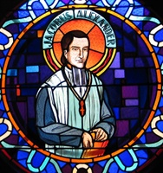
The Three Estates
First Estate – Clergy
Only 1% of the population but owned 10% of land
Paid no direct taxes or taille but collected tithes
Clergy were usually nobles
Provided some social services such as running schools, hospitals, orphanages.
Intolerant of dissent, interfered in politics
Criticized enlightenment for undermining religion

Slide 6
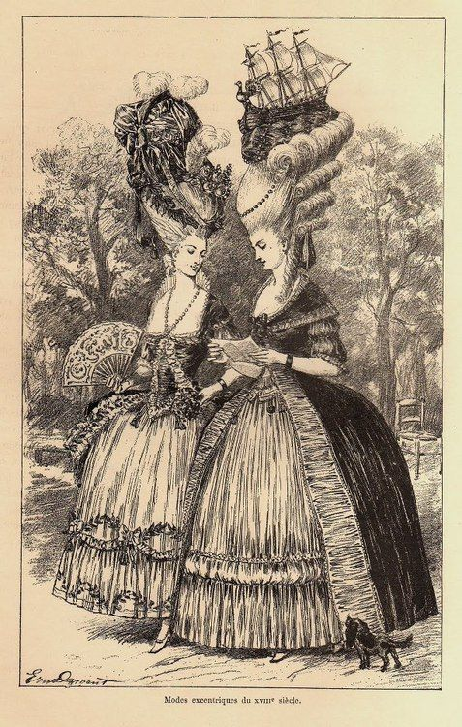
Second Estate – Nobles
Nobility
Occupied best jobs in government, army, courts & Church
2% of the population yet owned between 25-30% of the land
Paid no taxes

Slide 7
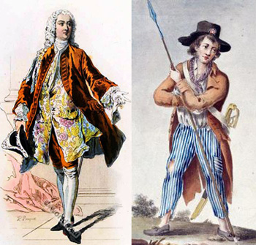
Third Estate
97% of the population
Divided into three groups.
Bourgeoisie = middle class which consisted of bankers, lawyers, doctors, & industrialists
Sans culottes = artisans and workers
Peasants = made up 75% of this estate
They paid all the taxes

Slide 8
Third Estate Grievances
They paid all the taxes
Forced corvee
forced labor exacted in lieu of taxes
Only nobles allowed to hunt
Ancient régime did not make “enlightenment” sense

Slide 9
Further Causes
Enlightenment Ideas
Inspiring new ideas from Enlightenment philosophers
Great Britain’s government limiting the king’s power
American colonists rebelled successfully against British king
New ideas changed government and society in other countries

Slide 10
A Financial Crisis
Severe economic problems affected much of the country
France in debt, spending lavishly, borrowing money, and facing bankruptcy
Hailstorm and drought ruined harvest; harsh winter limited flour production
People hungry and angry; clergy and nobility no help
Notes:
VIDEO (Encyclopedia Britannica): https://www.youtube.com/watch?v=ExoYJ8PczjA

Slide 11
First Events of the Revolution
By 1789, no group was happy
Clergy and nobility had lost power to monarchy
Bourgeoisie resented regulations
Poor worse off
Estates General meets
Desire for reforms
Voting process a problem
Third Estate proclaimed themselves National Assembly
Tennis Court Oath

Slide 12
Tennis Court Oath
Creation of the National Assembly was bold step
3 days later they were locked out of their meeting place.
Broke down door to a tennis court
Took oath not to leave until they finished writing a constitution

Slide 13
Storming of the Bastille
Parisians suspected the King might send troops to Paris. (July)
Searching for weapons, a mob stormed the Bastille, a medieval fortress, to obtain weapons.
King lost support of the troops.
This event became symbol of the French Revolution
Notes:
Video (The Storming of the Bastille): https://www.youtube.com/watch?v=3_8DkDftLMA

Slide 14
Great Fear spread
King to punish the Third Estate with foreign soldiers
Rumors of massacres
Peasants destroyed records and burned nobles’ houses

Slide 15
End part 1
TO BE CONTINUED…

Slide 16
Creating Creating a New Nation
The Revolution Begins: Part 2

Slide 17
Legislating New Rights
Feudal dues eliminated
Declaration laid out “liberty, equality, fraternity”
Inspired by the English Bill of Rights, American Declaration of Independence, and the writings of Enlightenment philosophers
“Men” are born equal and remain equal under the law
The rights did not extend to women

Slide 18
DECLARATION OF THE RIGHTS OF MAN WORKSHEET
Read The Declaration of the Rights of Man handout and answer the questions on the back.

Slide 19
Restrictions on Power
Louis tried to protect his throne
Angered the common people
Prices still high; mob broke into the palace demanding bread
Royal family was seized; National Assembly took bolder steps
Passed laws against the church, clergy, and public employees
Some outraged by actions

Slide 20
Formation of a New Government
In 1791, the Legislative Assembly is formed. Citizens gained broad voting rights, but rights were not universal.
Constitution restricted power of king and ended distinctions of birth. King and queen feared they would be harmed.

Slide 21
Foreign Powers
Austria and Prussia warned against harming monarchs
Austrian army defeats French
Financial strain of war, food shortages, and high prices
King blamed; action demanded

Slide 22
End of Monarchy
August 10, 1792 royal family imprisoned by mob
Radical faction took charge with National Convention
Monarchy abolished; France declared a republic

Slide 23
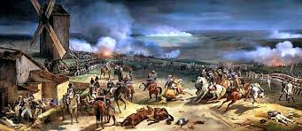
French revolutionary troops won the Battle of Valmy.
New French republic held ground against Europe’s Old Order.

Slide 24
End

