Slide 1
The Republic
Chapter 20.2

Slide 2
A Radical Government
In 1792, the radical representatives were in charge of the National Convention.
The constitutional monarchy came to a violent end, and France became a republic.
Factions
  Radical Mountain
  Moderate Girondins
  The Plain (swing voters)
No group had program or plan of action
  There were also personal rivalries
Leaders
  Marat
    Sansculottes, advocate of violence
  Danton
    Compromiser
  Robespierre
    Dedicated radical

Slide 3
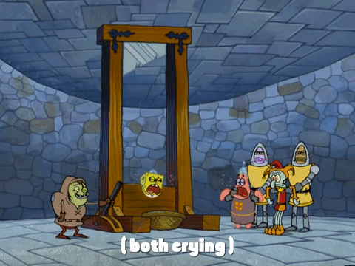
Executions
King put to death by guillotine
Europeans reacted with horror
  Revolution savagery condemned

Slide 4
Tightening Control
Committee of Public Safety set up to manage military defense
Drafted all able-bodied men between 18 and 45 for service
Established the Revolutionary Tribunal to protect the Revolution

Slide 5
Transforming Society
Leaders wanted to erase connections to old ways of life
Clergy members lost positions; churches closed in Paris
Robespierre created the cult of the Supreme Being
Metric system was introduced

Slide 6
The Reign of Terror
Course of Revolution
  Revolutionary leaders feared counterrevolution and took drastic actions with accusations, trials, and executions. This period was known as the Reign of Terror.
An Outbreak of Civil War
  Peasants, essentially conservative, only wanted an end to feudal dues.
  Remaining devoutly Catholic, the Vendée region opposed the Revolution in a civil war. The government put down the counterrevolution to regain control.
Accusations and Trials
  Robespierre used the Revolutionary Tribunal to rid the country of dissent.
  It started with the Girondists, but soon anyone who had ever criticized the Revolution, or who had connections to the Old Order, was in danger.

Slide 7
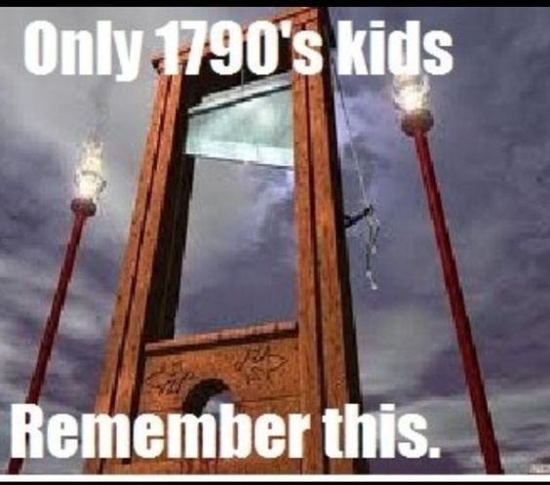
No Escape from the Terror
Death by Guillotine
  Most common sentence - death by guillotine
  Condemned paraded through Paris in open carts
  Mobs watched at scaffold; executions took less than one minute
Notes:
VIDEO (): https://www.youtube.com/watch?v=RGro55ke4dA

Slide 8
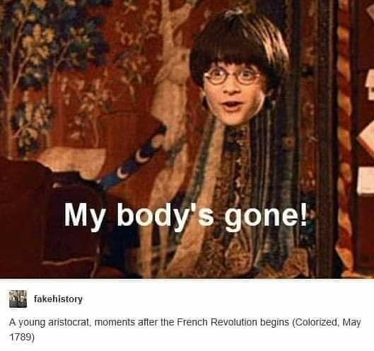
The Terror’s Victims
  No one was spared
    Royalty and nobility
    Peasants and laborers
    Danton and Robespierre
  40,000 executed in 10 months
  “Oh Liberty, what crimes are committed in your name!”

Slide 9

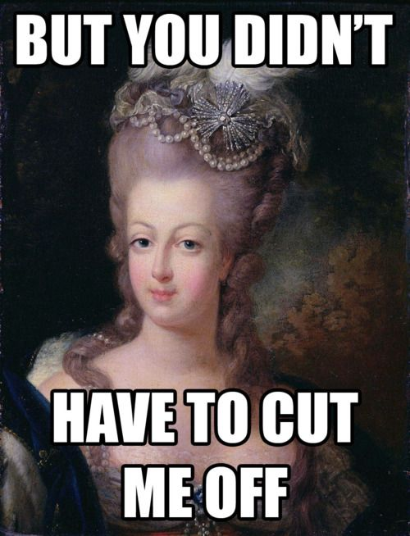

Slide 10
After the Terror
  France started over with new constitution in 1795
  Voting limited to property owners
  The Directory established
  High prices, bankruptcy, and citizens’ unrest continued
  Power vacuum developed

Slide 11

The French Revolution In A Nutshell
Notes:
VIDEO (3 mins – Summary of the French Revolution (In a Nutshell)): https://www.youtube.com/watch?v=VEZqarUnVpo
VIDEO (10 mins – The French Revolution In A Nutshell): https://www.youtube.com/watch?v=XmWc5BIhZHY

Slide 12
End

