Slide 1
Chapter 20.3
Napoleon's Europe

Slide 2
Napoleon's Rise to Power
Napoleon Bonaparte
Ruthlessly ambitious
Rose from army captain to ruler of France in a very short time
He took advantage of the turmoil of the French Revolution.

Slide 3
Napoleon's Rise to Power
Opportunities for Glory
Napoleon was a brilliant military leader
In charge of French interior at 26
Invaded Italy and Egypt
His defeat by Admiral Horatio Nelson kept from newspapers
Became national hero

Slide 4
Napoleon’s Rise to Power
Napoleon Seizes Power
Directory weak and ineffective
Fear of royalists and of European opposition
November 1799 coup d’état
France to be led by Consulate
Napoleon voted first consul, in effect a dictator
Napoleon promised order and stability, pledging to uphold key reforms. The French gave up some freedoms for peace and prosperity.

Slide 5
Emperor Napoleon
Once France under control, Napoleon turned to Europe & crowns himself Emperor Napoleon I

Slide 6
Emperor Napoleon
Desire for empire
Wanted to rule Europe and the Americas
French expedition to Saint Domingue (Haiti today) failed
Napoleon sold Louisiana Territory and turned his focus to Europe

Slide 7
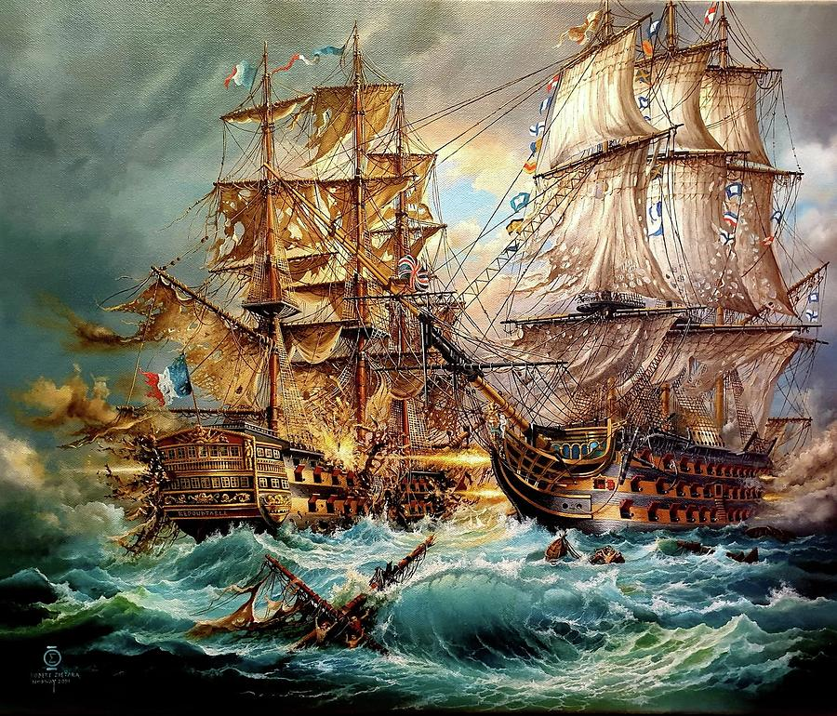
Quest to Conquer Europe
Napoleonic Wars Begin
Extension of wars fought during the French Revolution, would last a decade
France dominant power in Europe
French empire grew rapidly, but fell apart more quickly
Nelson and British navy won Battle of Trafalgar off coast of Spain
Napoleon defeated Russian and Austrian troops at Austerlitz

Slide 8
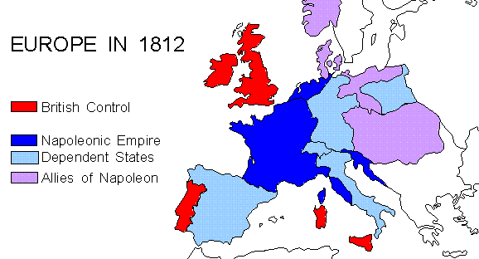

Slide 9
Continental System
The Peninsular War
“Nation of shopkeepers” Great Britain continued to defy Napoleon
Blockade prohibited French or allied ships from trade with Britain
Britain required ships from neutral countries to stop in British ports
War of 1812 one result
Troops to Portugal and Spain
Spanish people revolted in 1808
Great Britain stepped in to help
Guerrilla war with Spanish kept French busy
Napoleon finally pulled out of Spain

Slide 10
Napoleon Dominates Europe
Mastered Most of Europe
Through treaties, alliances, and victories in battle
Controlled much of Europe by 1812
Free of Control
Great Britain remained an enemy
Sweden, Portugal, and the Ottoman Empire escaped Bonaparte’s grip
Rewarded Relatives
Relatives were put in power; brothers on thrones of Holland, Naples, and Sicily
Sisters and stepson held powerful positions

Slide 11
Napoleon’s Policies
Church-State Relations
Antireligious nature of French Revolution over
Concordat recognized influence of Roman Catholic Church
Economic Reforms
Established the Bank of France to regulate economy
More efficient tax-collection system
Legal and Educational
Napoleonic Code developed
Order and authority over individual rights
Schools for government and military positions

Slide 12
Napoleon’s Policies
Legacy—Age of Napoleon
Democratic ideas
Equality before law, representative system
Spread of nationalism

Slide 13
End

