Slide 1
Chapter 20.4
Napoleon’s Fall and Europe’s Reaction

Slide 2
Disaster and Defeat
Portugal
Napoleon’s Peninsular campaign was a failure
He was surprised by inability to control Portugal
Russia
Czar Nicholas I didn’t like French troops on western border
Russia hurt by Continental System; country needed imports
Costly Mistake
Napoleon turned east in 1812
Hoped to teach Russia a lesson

Slide 3
The Russian Campaign
June 1812
Napoleon and army of 600,000 troops marched across Russian border
French Army
New recruits with no loyalty
Supplies lost or spoiled
Disease, desertion, and hunger
No One to Fight
Russian troops pulled east
French victory at Borodino, but Russian army still strong
Pushed to Moscow but found city in flames
Retreat Homeward
Ruined city, no winter supplies
Starvation and freezing temperatures decimated army
Only 94,000 men survived

Slide 5
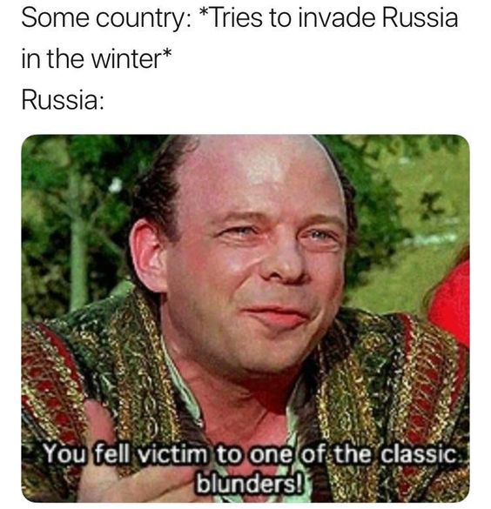

Slide 6
Defeat and Exile to Elba
Russia, Prussia, Austria, and Great Britain allied against France
Napoleon raised another army, but his troops were inexperienced
In October 1813 Napoleon defeated at Battle of the Nations near Leipzig
In March 1814, victorious allies entered Paris.
Terms of surrender—Napoleon gave up throne and went into exile on tiny island of Elba

Slide 7
The Last Campaigns
French monarchy restored with King Louis XVIII
King unpopular
Napoleon returns after year in exile
Louis panicked and fled
Napoleon declared him outlaw by allies
Paris cheered Napoleon’s return
Brief period of renewed glory called the Hundred Days

Slide 8
The Last Campaigns
Battle of Waterloo
Napoleon’s Final Days
Duke of Wellington led final confrontation
Battle of Waterloo
British and Prussian armies
Crushing defeat for Napoleon
End of the Napoleonic Wars
Tried to escape capture, sent to exile in Saint Helena
Volcanic island in South Atlantic
Remained imprisoned for six years
Died at 51; cause of death never determined

Slide 9
The Congress of Vienna
Negotiators
Lord Castlereagh of Great Britain
Czar Alexander I of Russia
Prince Klemens von Metternich of Austria
Charles-Maurice de Talleyrand of France
Metternich of Austria
Distrusted democracy and political change
Dominated the congress, wanted to restore the balance of power
Goals for Other Decision Makers
Make sure France could not rise again to such power
Put down revolution wherever it might appear
Remove traces of French Revolution and Napoleon’s rule

Slide 10
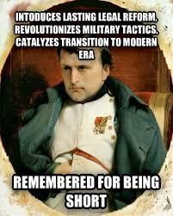

Slide 11
Redrawing the Map
National borders
Congress changed many borders
Wanted to strengthen nations surrounding France
New Countries
Union of the Dutch Republic and the Austrian Netherlands as the Kingdom of the Netherlands
Austria and 38 German states in German Confederation
Process
Countries that aided France lost territory
Countries that fought France gained territory
Talleyrand arranged trades
France’s loss
Was not allowed to keep any conquered territory
Boundaries back to 1792
Forced to pay indemnity, or compensation for damages

Slide 12
Restoring Monarchies
Napoleon had eliminated royal control in many countries.
Members of the old Bourbon royal family were returned to the thrones of Spain and Sicily.
Monarchies were restored in Portugal and Sardinia

Slide 13
Metternich’s Influence
His reactionary attitudes influenced politics and society.
Wanting a return to absolute monarchy, he despised constitutions, voting rights, and freedom of religion and the press.
Liberal ideas were suppressed in Austria, the German states, and northern Italy.

Slide 14
The Revolution’s Legacy
Was the French Revolution a failure?
After Congress of Vienna, monarchs ruled again
Citizens’ rights restricted
Nobles returned to their previous lifestyles
French Revolution changed Europe
Monarchies no longer secure
Common people learned they could change the world
Ideals of human dignity, personal liberty, and equality
Enlightenment crossed the Atlantic to Latin America, eventually inspired political movements in Asia and Africa

Slide 15
Crash Course
Notes:
VIDEO (Crash Course): https://www.youtube.com/watch?v=Pd6E38FfuMg

Slide 16
ENd

