Slide 1
Chapter 8: The Progressive Movement
Section 1: Roots of Progressivism

Slide 2
The rise of progressivism
Progressivism era:
___________________________________
___________________________________
  They did this with reforms to
    ____________________
    ____________________
    ____________________
Progressives
  Belonged to both major political parties
  Were educated, middle class Americans
  Had ideas about how to fix problems in society
a time when many Americans tried to improve their society.
Society
the economy
Politics

Slide 3
Progressives thought to improve faith in
  ______________________________
    Light bulb, telephone, & automobile
  ______________________________
    Skyscrapers & railroads
Muckrakers
  Journalists who investigated ______________________________ & ______________________________
    They were named for a character who’d scrape the filth on the ground, but ignore everything else.
Science
Technology
scandal
corruption

Slide 4
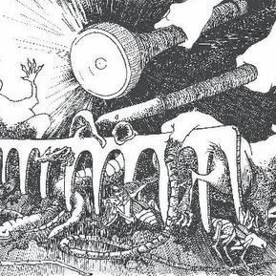
Muckrakers
President Theodore Roosevelt agreed with many of the charges made by the muckrakers, but accused them of using methods that were irresponsible and sensationalistic. The name actually comes from a John Bunyan character in Pilgrims Progress who spent his entire life raking muck, never lifting his eyes up from his labors.

Slide 5
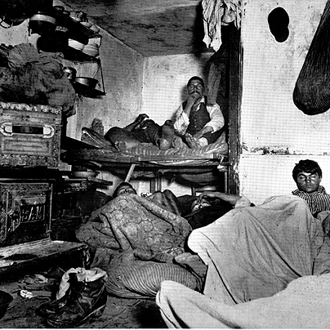
How the Other Half Lives
Jacob Riis’s documentation of the squalid living conditions in New York City slums in the 1880s.

Slide 6
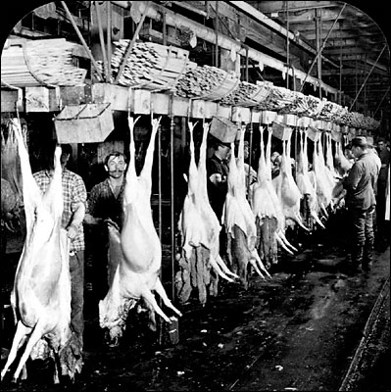
The Jungle
Upton Sinclair’s fictional work which exposed conditions in the U.S. meat packing industry. The novel caused a public uproar that contributed in part to the passage a few months later of the 1906 Pure Food and Drug Act and the Meat Inspection Act.

Slide 7
Reforming Government
Progressives condemned government corruption
  Using ____________________________ efficiency
  Politicians would hire _______________________
    Problem: they aren’t a right fit
Direct election of senators
  ______________________________ Amendment
  Before, this would be done by the ______________________________
business
friends
17th
state legislature

Slide 8
suffrage
Definition: the right to vote
History
  Women had been trying to gain suffrage since before the ______________________________
  African American men were granted voting rights, but women were still denied
  They focused on ___________________________________ & ___________________________________
1920 success
  _____________________ Amendment was ratified
Civil War
Constitutional amendments
state governments
19th

Slide 9
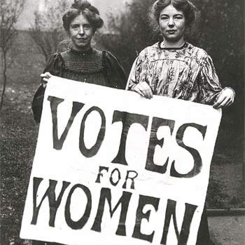
Suffragettes

Slide 10
Reforming safety
Child labor
  Muckraker stories of “______________________”
    10 year olds paid 60 cents for 10-hour day
    States pass limits on hours children can work
Health/safety codes
  Worker compensation laws
  Building and Health codes
    Tragedy at the Triangle Shirtwaist Company
Prohibition Movement
  Pressed to reduce the consumption of ______________________________
breaker boys
alcohol

Slide 11
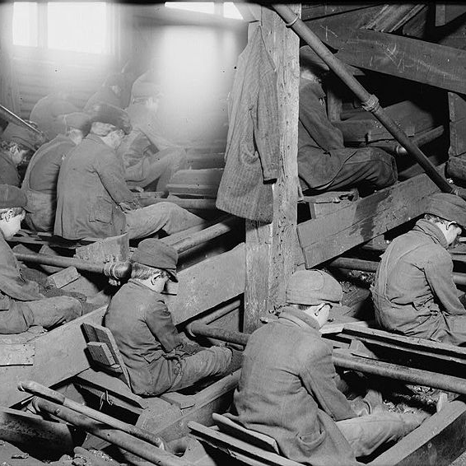
Breaker Boys
Breaker boys sort coal in at an anthracite coal breaker near South Pittston, Pennsylvania, in 1911. Photograph by Lewis Hine for the National Child Labor Committee.

Slide 12
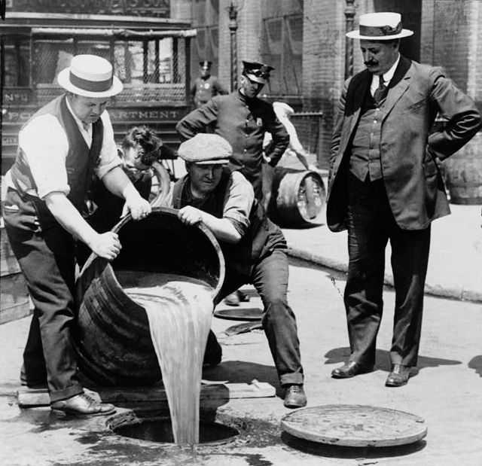
18th Amendment: Prohibition
Alcohol
Down the Drain!

Slide 13
Q1
Efficiency Progressives had a strong faith in
  the basic goodness of humanity.
  politicians to serve the people.
  science and expertise.
  luck.

Slide 14
Q2
Tragedy at the Triangle Shirtwaist Company led to
  child labor laws.
  standards for safe use of machines.
  laws against harmful fumes.
  building codes requiring fire escapes.

Slide 15
Q3
Muckrakers’ Focus
Large Corporations | Government | Social Problems
Ida Tarbell writes series of articles critical of Standard Oil. | David Graham Philips describes influence of money in the Senate. | Jacob Riis writes How the Other Half Live, a book that discusses poverty, disease, and crime.
Charles Edward Russell writes about the beef industry. | Lincoln Steffens writes report on vote stealing. | Muckraker articles lead to public debates on social and economic problems.
According to the graphic, which of the following was not a cause of concern for the Muckrakers?
  social problems
  corporations
  government
  military actions

Slide 16
Q4
In general, progressives support reforms that would improve the lives of
  business owners.
  workers.
  politicians.
  commissioners.

Slide 17
End

