Slide 1
The Silk Road
Chapter 8.2

Slide 2
During the Han Dynasty in China, 206 B.C.E. to 220 C.E., a period of stability was established across China.
One result of this stability was an increase in trade between the cities of the dynasty’s region.
This trade spread to regions that are now India, Pakistan, Iraq and Iran, and as far as the Mediterranean Sea to Rome.

Slide 3
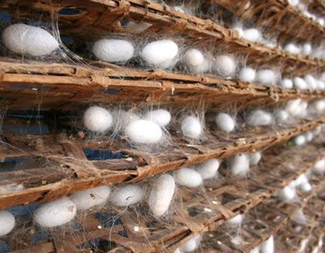
How It’s Made
Commodities such as silk had become known to people in Rome through regional trade within their empire as it spread west.
Silk was highly desired in cities like Rome, where people wanted it for clothing and decoration. Silk was very profitable for producers in China.
Notes:
Video (How It’s Made): https://www.youtube.com/watch?v=eqFm_7KyfHI

Slide 4
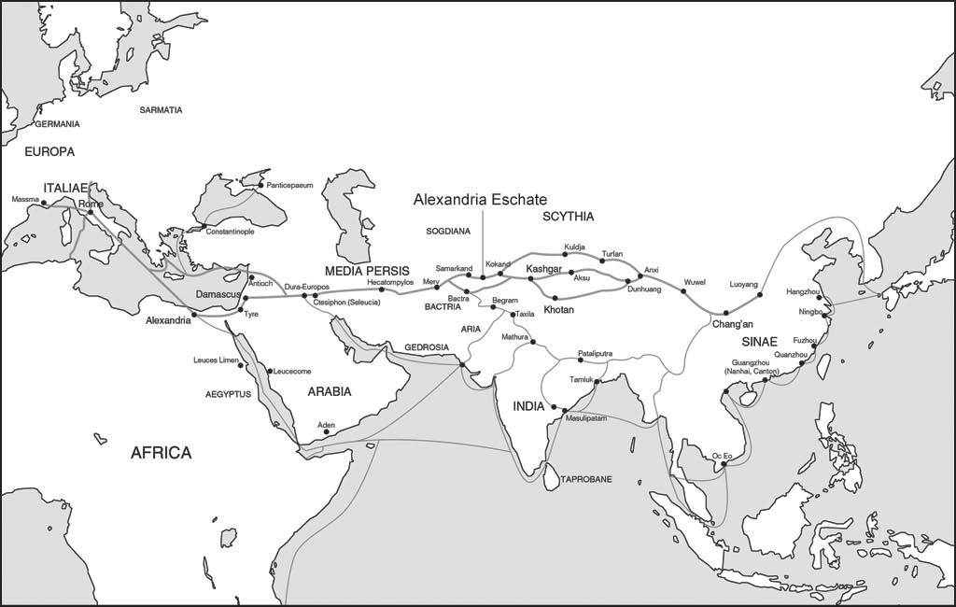
Map of the Silk Roads
Notes:
The Silk Road connected the West with the East through cities like Alexandria Eschate (Alexandria the Furthest) founded by Alexander the Great in 329 B.C.E. The Han Dynasty’s capital Chang’an (now spelled Xi’an) in central China was the main city at the eastern end of the Silk Road.
The Silk Road was actually a series of roads extending north and south. People used these roads to carry goods between Rome and Chang’an. At times, sea routes carried this trade, as maritime technologies improved or when violence threatened land traders. When pirates and other perils faced the merchants on the sea routes, trade increased on the land routes.

Slide 5
What Was Traded
Goods (items) That Spread
Other Things That Spread
Magnetic Compass
Silk
Gunpowder
Ceramics
Dates
Copper
Herbs
Gold
Religions
Cultures
Ideas
Languages
Customs
Scientific Knowledge
Diseases
The Bubonic Plague

Slide 6
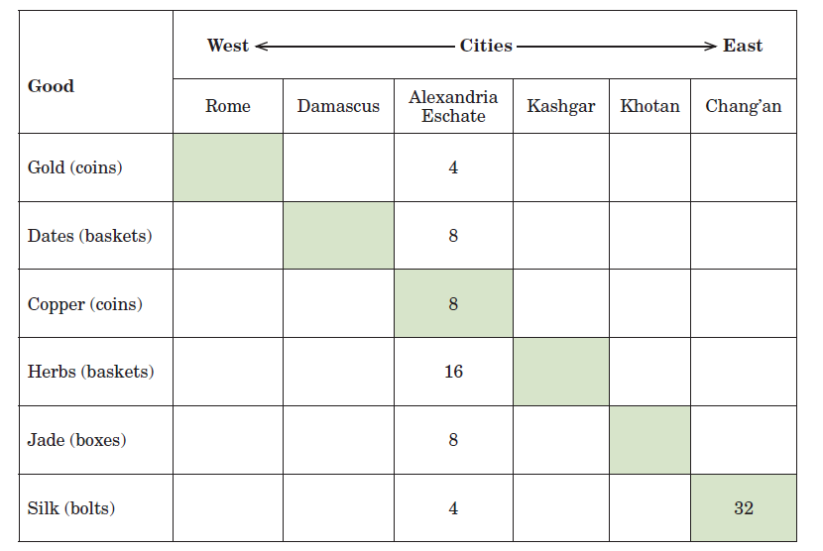
Bartering along the Silk Road
4
4
8
16

Slide 7
Assignment
Fill in the rest of the table
Once the information is complete, it will help you answer the questions in Parts I, II, and III

Slide 8
END

