Slide 1
Chapter 9 – World War I and Its Aftermath
Section 1 – The United States Enters World War I

Slide 2
Alliances & Militarism
In the 1800s, Germany created an enemy of __________________ when they defeated their army and took a border area of territory.
For protection, Germany formed the Triple __________________ with Italy and Austria-Hungary.
__________________ is the aggressive build-up of armed forces to intimidate and threaten other nations.
Germany’s military build-up freaks out France (and Russia), who create an understanding with long-standing rival, _________________________.
France
Alliance
Militarism
Great Britain

Slide 3
Alliances
Austria-Hungary
Belgium
France
Germany
Russia
Serbia
United Kingdom
Austria-Hungary
Belgium
France
Germany
Russia
Serbia
United Kingdom

Slide 4
Imperialism & Nationalism
Imperialism
__________________, or a country controlling others, had become a very popular idea in Europe.
__________________, or intense pride in one’s homeland, became a very powerful idea in Europe.
“My country’s better than yours!”
The ________________ wanted their land back from the Austro-Hungarian Empire.
Lesson of History #2: Archduke __________________________ and his wife are assassinated by Serbian extremists.
Nationalism
Serbians
Franz Ferdinand

Slide 5
Alliances Are Triggered
Austria-Hungary
Belgium
France
Germany
Russia
Serbia
United Kingdom
Austria-Hungary
Belgium
France
Germany
Russia
Serbia
United Kingdom

Slide 6
Late 1914 – German weapons
Christmas 1914 – “The Silent Night”
1915 - Italy jumps to the Triple Entente
Question: What is neutrality? If your friends were fighting, could you choose sides? How does this relate to the beginning of WWI?
Notes:
VIDEO (War Horse charge scene – machine guns): https://www.youtube.com/watch?v=FXLcbrD6nsQ

Slide 7
Americans take sides
Pro-Central Power Sympathizers
8 million German Americans
Why?
4.5 million Irish Americans
Why?
Pro-Neutrality
“Preparedness” movement logic:
“Preparing for war is the best way to stay out of it.”
“If the U.S. is pulled in, it’s better to be prepared.”

Slide 8
Americans take sides
Pro-Allied Power Sympathizers
The general public share ties to __________________ heritage and the __________________
American government and military back the British
The British control war news to the U.S.
American __________________ and banks support the __________________
__________________
Information designed to influence opinion
British
French
businesses
Allies
Propaganda

Slide 9
Moving to War
Hannawi Lesson #1 – American’s don’t like it when people blow up their ships, er, stuff
The British __________________ German ports
U.S. dislikes the inspection of our ships
Even more, the U.S. dislikes the German’s announcement to sink any ships around Britain
May 7, 1915 – the __________________ is sunk
1,200 die, including _______ Americans
Germans promise they won’t sink any more merchant ships… without warning
blockade
Lusitania
128

Slide 10
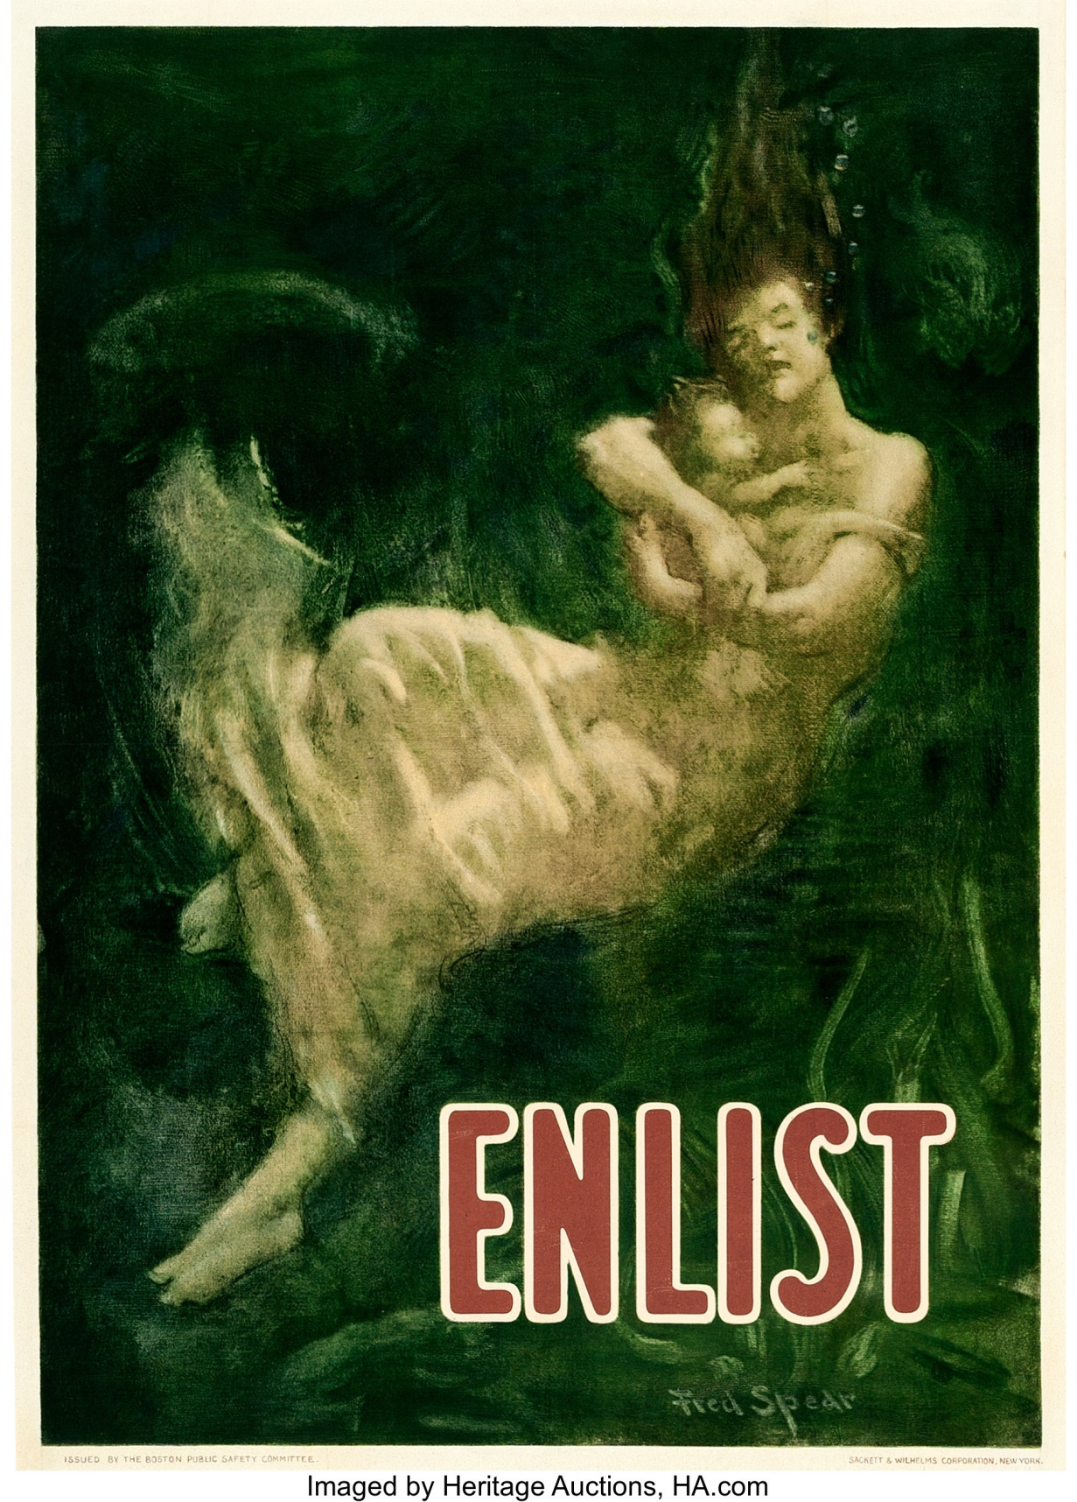
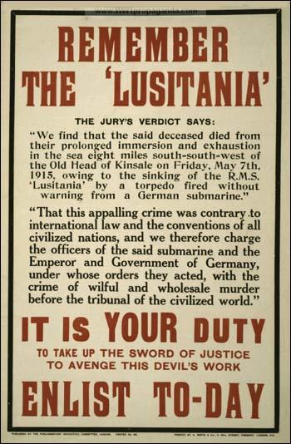

Slide 11
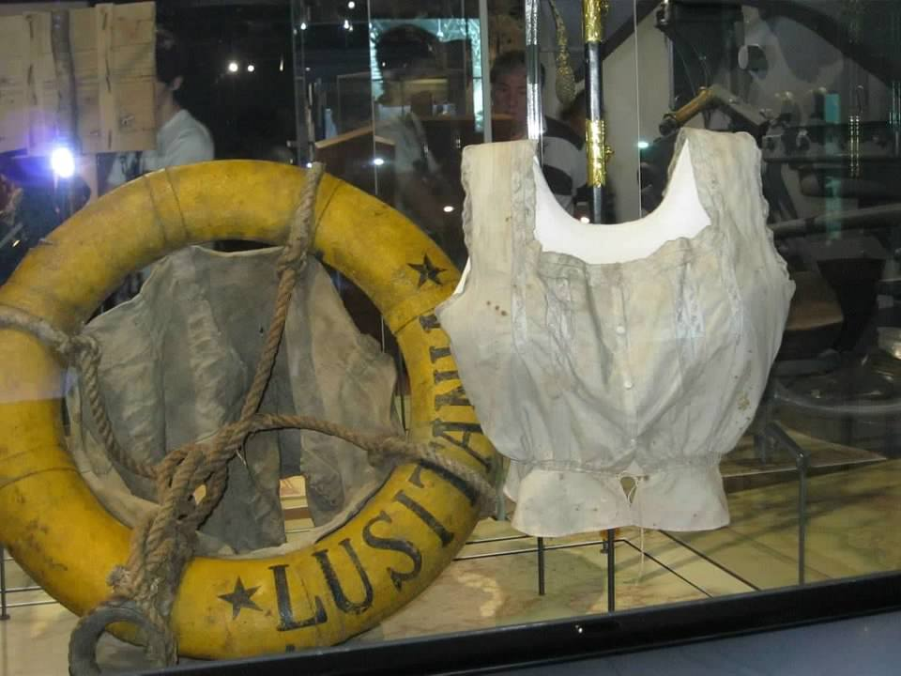

Slide 12
The U.S. Declares War
Zimmerman
__________________ telegraph
In January 1917, the Germans make an offer to __________________: “Join us, and Germany will restore Texas, New Mexico, and Arizona”
The British intercept it, the intelligence is leaked
Unrestricted __________________ warfare
HANNAWI LESSON #1!!!!
Between February-March, ____ American ships are sunk
On April 6, America goes to war
Mexico
submarine
6

Slide 13
END

